Slide 1
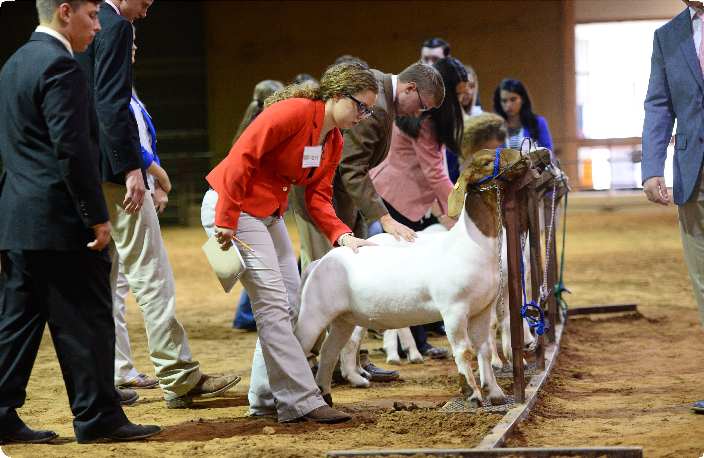
Texas 4-H Livestock Judging
Exploring Texas 4-H Livestock Judging
texas4-h.tamu.edu
The members of Texas A&M AgriLife will provide equal opportunities in programs and activities, education, and employment to all persons regardless of race, color, sex, religion, national origin, age, disability, genetic information, veteran status, sexual orientation or gender identity and will strive to achieve full and equal employment opportunity throughout Texas A&M AgriLife.

Slide 2
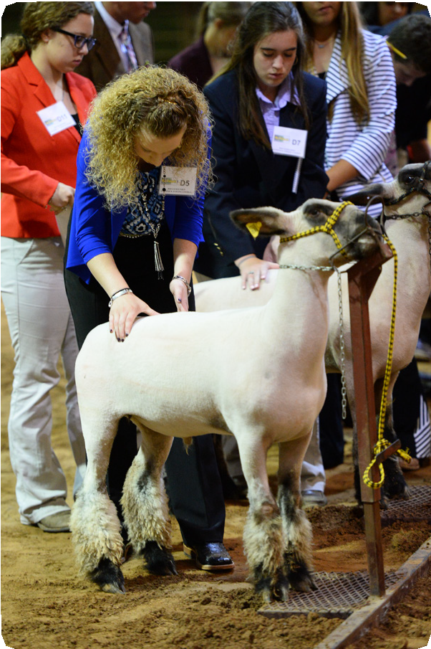
TEXAS 4-H LIVESTOCK JUDGING
Description
The Texas 4-H Explore series allows 4-H volunteers, educators, members, and youth who may be interested in learning more about 4-H to try some fun and hands- on learning experiences in a particular project or activity area. Each guide features information about important aspects of the 4-H program,
and its goal of teaching young people life skills through hands- on experiences. Additionally, each guide contains at least six learning experiences, which can be used as a project guide, or as activities for six different 4-H meetings.
Purpose
Texas 4-H is designed to develop the youth of our state into productive adult citizens. The 4-H Program uses a non-formal educational process of engaging youth in an “learning by doing” process. This includes hands- on opportunities, participation in workshops and clinics conducted by volunteer leaders or professionals, as well as competitive experiences which allow 4-H members to demonstrate the knowledge they have gained. Through this entire process, the youth are learning key life skills such as working with others, teamwork, cooperation, and goal setting.
Through all experiences, youth get to interact with adult volunteers and county Extension agents.
What is 4-H?
4-H members across the nation are responding to challenges every day in their communities and their world.
As the youth development program of the Cooperative Extension System of land-grant universities, 4-H is the nation’s largest youth development organization, empowering six million young people throughout the United States. Cooperative Extension of 1862 and 1890 land-grant universities provide leadership to engage young people in 4-H in all 3,007 counties of the United States. The impact of the Cooperative Extension partnership is profound, bringing together National Institute of Food and Agriculture of USDA, land grant universities and county government to resource learning opportunities for youth.
Through America’s 110 land-grant universities and its Cooperative Extension System, 4-H reaches every corner of our nation—from urban neighborhoods to suburban schoolyards to rural farming communities.
With a network of more than 6 million youth, 600,000 volunteers, 3,500 professionals, and more than 25 million alumni, 4-H helps shape youth to move our country and the world forward in ways that no other youth organization can.
Texas 4-H
Texas 4-H is like a club for kids and teens ages 5-18, and it’s BIG! It’s the largest youth development program in Texas with more than 550,000
youth involved each year. No matter where you live or what you like to do, Texas 4-H has something that lets you be a better you!
You may think 4-H is only for your friends with animals, but it’s so much more! You can do activities like shooting sports, food science, healthy living, robotics, fashion, and photography.
Look for 4-H clubs at your school, an after-school program, a community center, or even on a military base or through the reserves for military families.
Texas 4-H is part of the Texas A&M AgriLife Extension Service and the Texas A&M System. Founded in 1908, 4-H is the largest youth
development program in Texas, reaching more than 550,000 youth each year.
The 4-H Motto and Pledge
“To Make the Best Better!”
I pledge: My HEAD to clearer thinking, My HEART to greater loyalty, My HANDS to larger service and My HEALTH to better living, For my Club, my Community, my Country, and my world.
Participating in 4-H
4-H is a great program because it provides options for young people to participate. From a 4-H club located in your community, a SPIN club that focuses on one particular project area, or participating in 4-H through your classroom at school, 4-H allows youth to learn in many different environments. If you are interested in joining 4-H, contact your County
Extension Office and ask for a list of the 4-H clubs in your area. If you are a school teacher/educator and would like to use 4-H curriculum or these project guides in your classroom, contact your Extension Office as well for assistance.
Texas 4-H Youth Development | texas4-h.tamu.edu

Slide 3
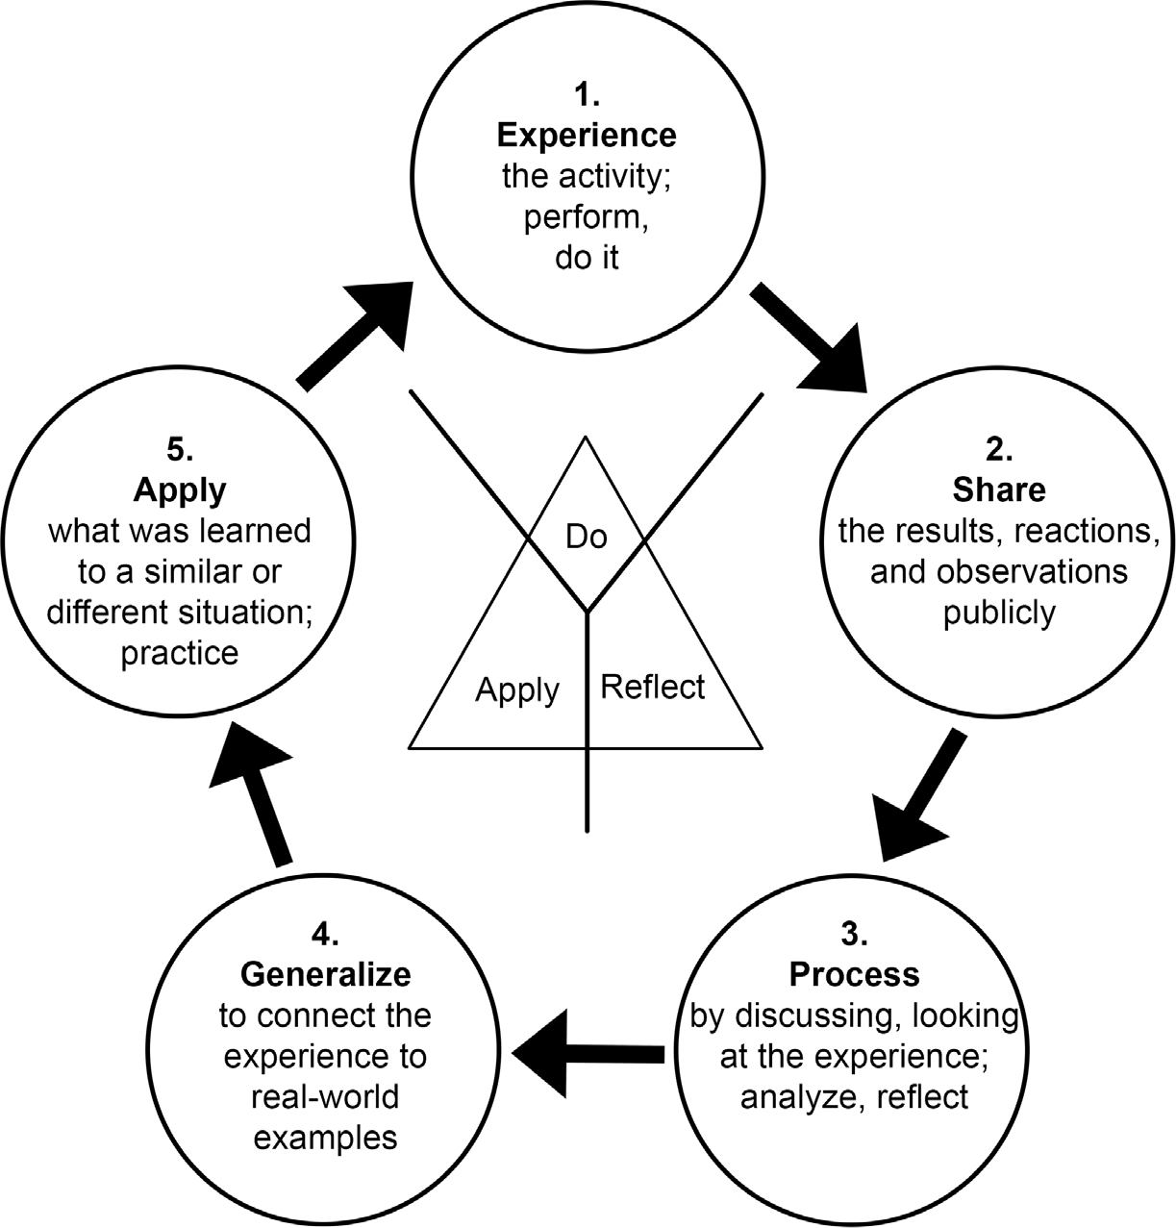
4-H “Learning by Doing” Learning Approach
The Do, Reflect, Apply learning approach allows youth to experience the learning process with minimal guidance from adults. This allows for discovery by youth that may not take place with exact instructions.
EXPLORE THE CONTENT
Introduction of the topic, overview and exploration of content, and review of objectives
Build on knowledge by learning more and advancing to the another
topic/level
Youth do with limited
“how to” instructions.
Youth use the skills learned in other parts of their lives.
Youth describe results of the experience and their reaction.
Youth connect the discussion to the larger world.matter).
Youth relate the experience to the learning objectives (life skills and/or subject matter).
Texas 4-H Youth Development | texas4-h.tamu.edu

Slide 4
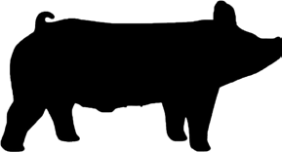
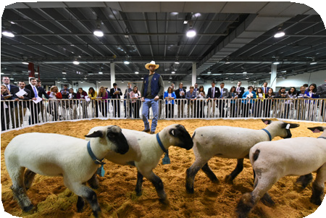
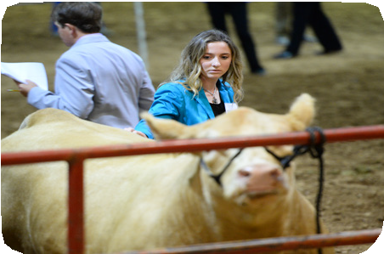
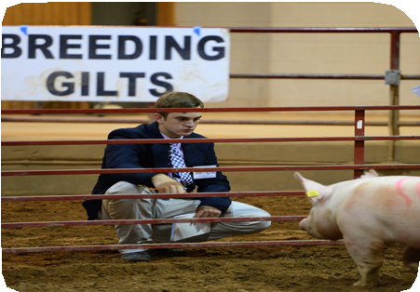
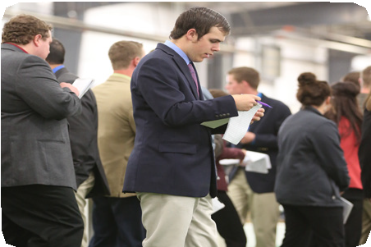
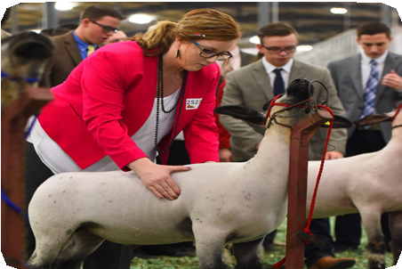
4-H LIVESTOCK JUDGINGLessons
Lesson 1
Overview and Purpose of the Contest ............. . 2
Lesson 2
Market Animal Evaluation. . . . . . . . . . . . . . . . . . . . 4
Lesson 3
Breeding Animal Evaluation ..................... .26
Lesson 4
Effective Note Taking ............................ 31
Lesson 5
Reasons and Questions ......................... . 35
Developed by: Dottie Goebel Billy Zanolini Courtlyn Ranly Charles Seely Cory Trimble Robert Scott
Chad Coburn Lainey Bourgeois Kelley Ranly Edward Schneider Micah Walker
Livestock Judging
Texas 4-H Youth Development | texas4-h.tamu.edu

Slide 5
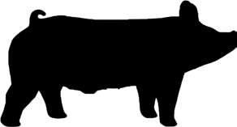
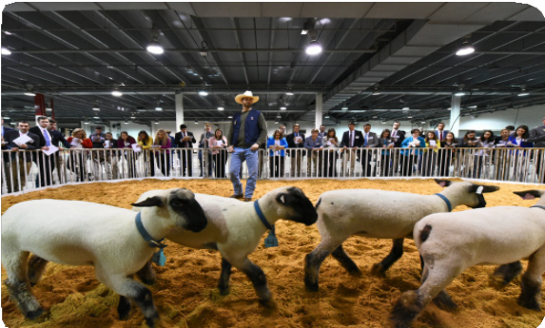
4-H LIVESTOCK JUDGINGLessons
Overview and Purpose of the Texas 4-H
Livestock Judging Contest
EXPLORE THE CONTENT:
Livestock judging is a highly competitive experience that enhances independent decision-making abilities while challenging participants to process information quickly and be able to defend a position or decision. Livestock judging is the visual appraisal
of an animal’s physical traits, including positive and negative features. The ultimate goal in judging livestock is to compare and contrast the four animals in a given class against one another, and then compare them to what is considered the “ideal” animal.
Livestock judging allows personal growth and development as it requires a student to think critically. It can teach youth
valuable time management skills, responsibility, and how to be competitive while demonstrating honesty, integrity, and respect. Livestock judging instills these valuable life skills, but also provides opportunities for learning about selection and obtaining general knowledge about the livestock industry, as well as interacting with current industry leaders which may prove beneficial throughout the one’s 4-H career and into adulthood.
OBJECTIVES:
The 4-H member will:
Understand the basic concept of a livestock judging contest.
Know what is appropriate to wear to a contest.
Age Divisions and Teams:
Livestock judging participants can compete within three age divisions. Junior-aged competitors range from eight to ten-years- old on or before September 1 of each year. Intermediates range from eleven to thirteen-years; and senior–aged participants are fourteen to eighteen-years-of-age. Teams consist of up to four members within the same age division. The contest is completed individually, but the top three individual scores of each team are calculated for the overall team score. Before traveling to a judging contest, it is important to check with each contest’s guidelines to ensure the correct age division and team rules are followed. Some contests may combine the junior and intermediate divisions.
Classes:
Livestock judging contests are generally set up the same across the state. Typically, a 4-H contest will consist of 8-10 classes, four being market and the other four being breeding, though this number varies depending on the contest and availability
of livestock. All animals will be haltered, in a stanchion, or in a smaller pen for evaluation. Animals that are tied up or in a
stanchion will be numbered one through four, from left to right. Livestock in a pen will have a number on each animal. Participants are divided into groups and given twelve to fifteen minutes
to evaluate each class. Based upon the class being labeled as breeding or market, youth will follow industry guidelines to rank the four animals from best to worst. After placing each class, they will answer questions or give reasons on a couple of the classes

Slide 6
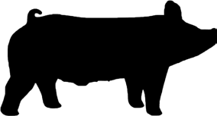
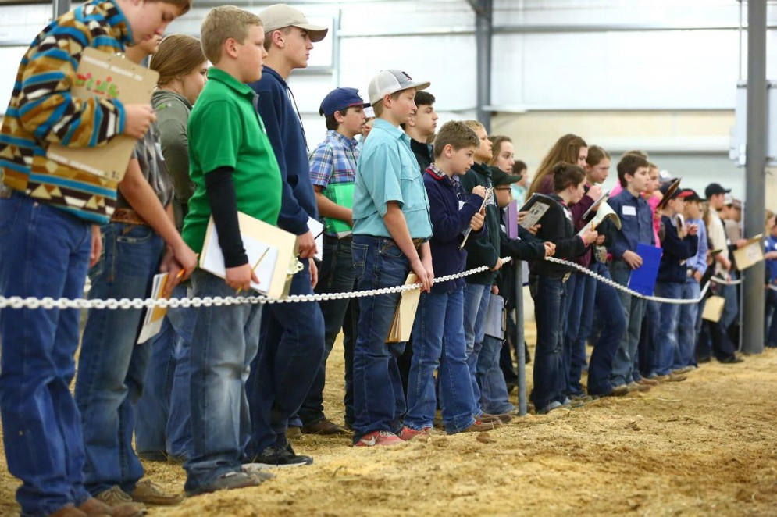
LIVESTOCK JUDGING
depending on their age and the contest.
Attire:
The proper attire for a judging contest varies for each event. At most TX 4-H/FFA and regional contests, it is appropriate to wear nice jeans, a button-down collared shirt, and leather boots or closed-toed shoes. Some contests may require participants to dress more formally in slacks, a blazer, and a tie for young men. Contestants giving reasons at a contest should dress more professionally. As a general rule, ladies should keep make-up and jewelry subdued. Gentlemen should be clean shaven with a well-presented haircut. No identifying clothing should be worn, including ranch name, county name or student name on shirts. Be sure to check with your County Extension Agent before leaving for a contest for the proper attire.
REFLECT:
Is it appropriate to wear t-shirts, athletic shorts, or flip flops to a livestock judging contest?
How many members can you have on one junior, intermediate or senior team at a judging contest?
APPLY:
Build a team of aspiring contestants closely to you in age and begin to practice and travel together. Livestock judging is a competitive, yet fun and friendly competition that has the potential to prepare you for multiple aspects of your future. Reach out to your County Extension Agent or Ag Science Teacher for help and advice.
How do you think the skills and knowledge learned through livestock judging might be helpful in a future career?

Slide 7
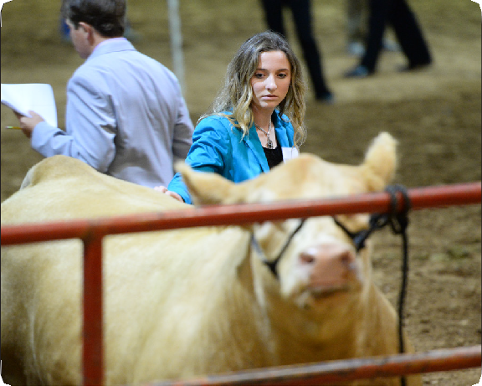
4-H LIVESTOCK JUDGINGLessons
Market Animal Evaluation
EXPLORE THE CONTENT:
Market animal evaluation plays a major role in a livestock judging contest, and is highly important in the livestock production industry. Market animals are solely analyzed on their phenotype or physical features, which include: muscle shape, finish, structure, and balance/eye appeal. The genetic component, or Expected Progeny Differences (EPDs), are not utilized in this section of the contest. In terms of market animals, a livestock judging participant should expect to judge steers, lambs, goats, and barrows at any given contest. It is important to remember that livestock judging is opinion-based and classes of livestock may have a different official placing depending on the person evaluating. Knowing the evaluation criteria for market animals
is also extremely helpful when selecting projects. An evaluation
TIME:
20-40 minutes
criterion within each species is very important. Create a list of major traits which are important to that specific class within each species. For example, with market steers, the priority list might consist of: muscle, market readiness (fat), structure, and balance.
MATERIALS NEEDED:
One PowerPoint or live animal class of each species (wethers, barrows, and steers).
Key Terms:
Expressive – Tone and definition of muscling through the forearm, topline, and rear quarters.
Base width – Amount of space between the front and back legs when the animal is standing square with all four feet underneath him.
Balance – The overall combination of muscle, fat, skeletal correctness, and eye appeal.
Skeletal Correctness—The animal’s ability to remain sound and flexible while in motion as well as its ability to maintain ideal hoof, hock and knee placement while at rest.
OBJECTIVES:
The 4-H member will:
Learn the evaluation criteria for judging market animals in a livestock judging contest
Learn basic anatomy of market animals
Learn common terminology of market animal evaluation
Understand the importance of market livestock evaluation
Market Steers:
Muscle Evaluation
Muscle shape, expression, and volume are the top evaluation criteria for all market animals. In market steers, muscle can be found starting at the topside of the animal’s skeleton all the way to the ground. Evaluation of muscle in market animals is done from the top, from the side, and from behind. In addition, base width is a good indicator of muscle and should be considered
in evaluation as well. In some livestock judging contests, participants are allowed to handle market animals. Handling should be done with purpose, and serves as a confirmation to the visual appearance of the animal. It is important to have a visual representation of what the animal is expected to feel like before handling. Market steers are handled down their top, from front

Slide 8
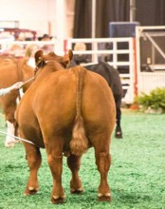
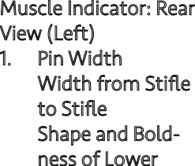
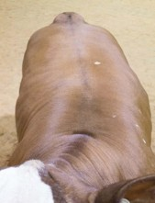
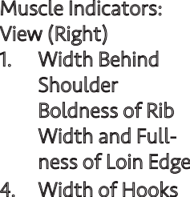
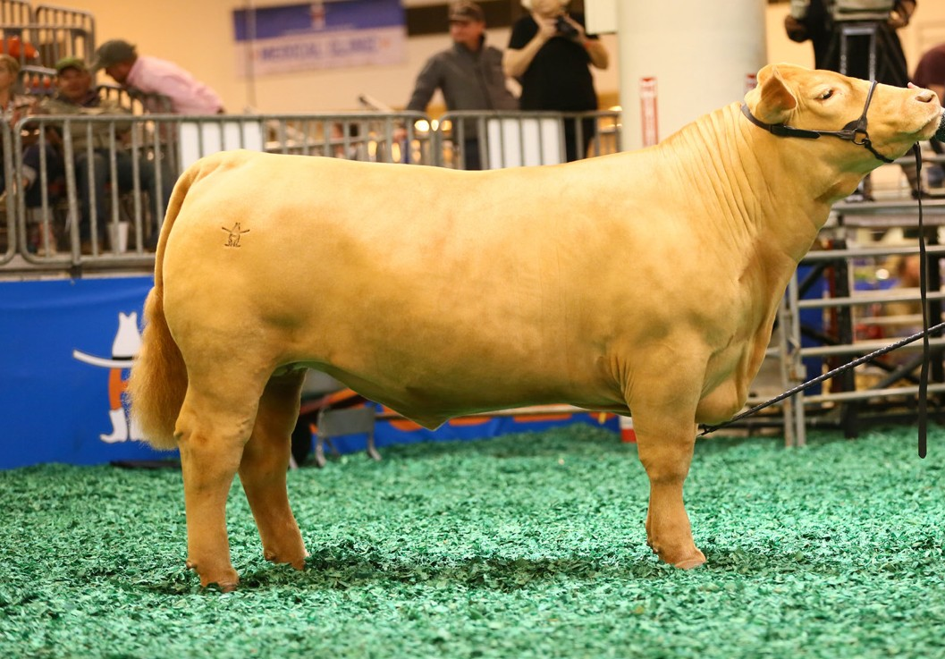
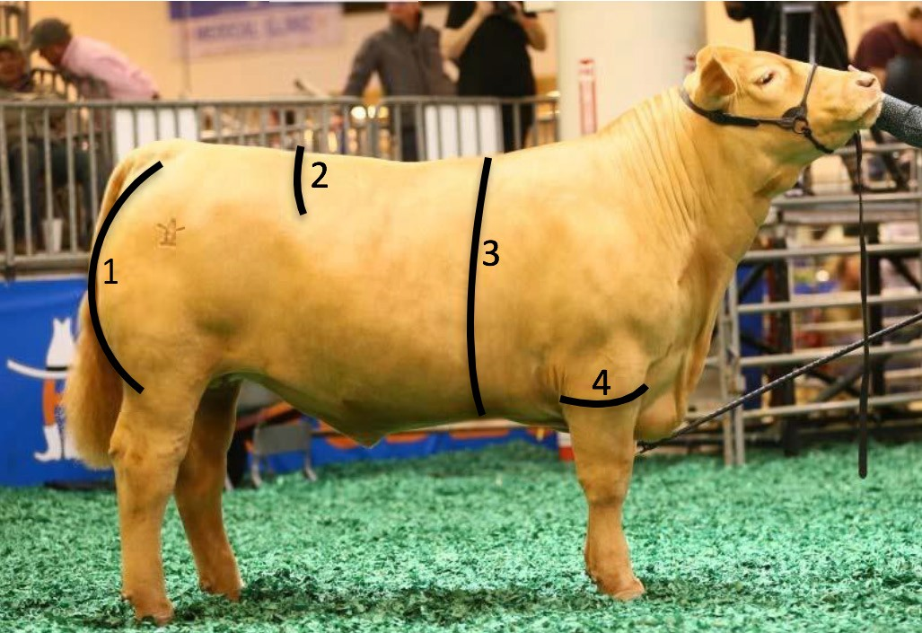
LIVESTOCK JUDGING
to back. Beef cattle that stand square and wide on all four corners tend to allow for more shape and dimension of muscle on the top side of their skeleton and from behind. Boldness of rib is also a good indicator that the market steer will offer more natural width and volume of muscle. Heavy muscled steers tend to get progressively wider as you work down their top line. They are ideally bold and expressive behind their shoulders, come into a deep, full loin edge, and are wide and level from hooks to pins. This muscle shape is carried down from behind, as heavy muscled steers are typically widest from stifle to stifle and carry their advantage of width and dimension of muscle through their lower quarter. From the side, heavy muscled steers are expressive and dimensional in their forearm and through their center body. In addition, the steer should exhibit shape and turn to their hindquarter when evaluated from a distance. Below is a depiction of these traits:
Muscle Indicator: Rear View (Left)
Pin Width
Width from Stifle to Stifle
Shape and Bold- ness of Lower Quarter
Base Width
Muscle Indicators: Top View (Right)
Width Behind Shoulder
Boldness of Rib
Width and Full- ness of Loin Edge
Width of Hooks
4
3
1
2
2
1
3
4
Muscle Indicators: Side View
Turn of Quarter
Depth of Loin Edge
Depth and Spring of Rib
Width of Forearm
2
1
3
4
Evaluation of Finish
All species of livestock evaluated in a livestock judging contest deposit fat from front to back and top to bottom.
In market animals, fat or condition is referred to as finish or market readiness. In a livestock judging contest, it is recommended to assume that all market animals are the same age and ready for harvest. Market steers are harvested at twelve to eighteen months of age and around 1,200 to 1,400 pounds. Each species has an optimal endpoint for market readiness from a quality and yield grade standpoint, as well.

Slide 9
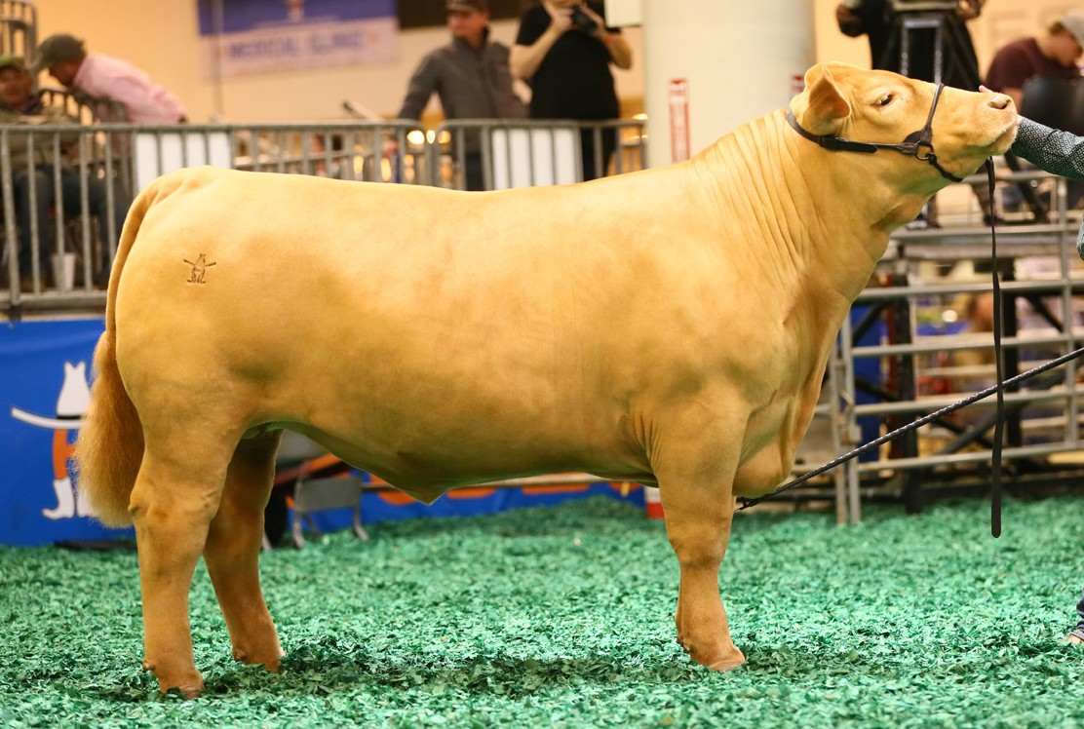
LIVESTOCK JUDGING
Evaluation of Finish
All species of livestock evaluated in a livestock judging contest deposit fat from front to back and top to bottom.
In market animals, fat or condition is referred to as finish or market readiness. In a livestock judging contest, it is recommended to assume that all market animals are the same age and ready for harvest. Market steers are harvested at twelve to eighteen months of age and around 1,200 to 1,400 pounds. Each species has an optimal endpoint for market readiness from a quality and yield grade standpoint, as well.
Yield grade is a USDA measurement used to measure the percent of boneless, closely trimmed retail cuts, also referred to as cutability. Market steer retail cuts include boneless cuts from the round, loin, rib and chuck. Yield grades range from 1-5 with 1 being the highest cutability and 5 being the lowest cutability. Steers that are trimmer and have less fat deposited over their body will traditionally have a lower numerical yield grade. Steers that have a yield grade of 4 or 5 will typically have a high degree of finish. The degree of finish on a market steer also affects the animal’s quality grade. Quality grade is a USDA measurement that measures the expected palatability and marbling score. Prime, choice, select, standard, commercial, utility, and cutter/canner are all grades used to describe the quality grade for a beef carcass cut. Desirability of grade is dependent on the endpoint market of the beef, as some purchasers may prefer lean beef while others prefer more fat and marbling. While there is not a direct correlation with external fat and marbling, analyzing the degree of finish or yield grade can be a predictor for the quality grade of a market steer.
Market steers have an ideal fat thickness of 0.4 inches with a range of acceptability from 0.3 inches to 0.5 inches. Market animals have several external finish indicators that determine the amount of finish that the animal carries. Fat deposits in a market steer are found in the brisket, over the 12th and 13th ribs, down their topline, at their tail head, in their flank, and in their cod. An ideally finished steer will be full in his brisket, smooth over his 12th and 13th ribs and down his top, and have depth to his flank. A visual representation of finish is indicated on the yellow steer below. This steer is ideally finished, meaning that he is full and clean in his brisket, smooth over his rib and down his top, and has some depth and fill to his flank. He does not have large fat deposits in his pones or cod, but he maintains enough finish to be smooth and filled out in those areas.
4
Finish Indicators:
Brisket
Rib (12th & 13th)
Topline
Tail Head (Pones)
Flank
Cod
5
3
2
1
6

Slide 10
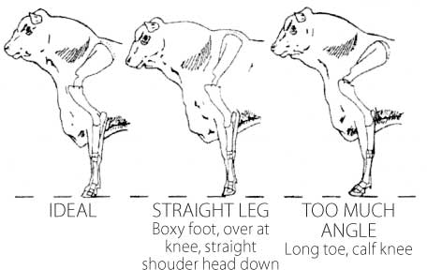
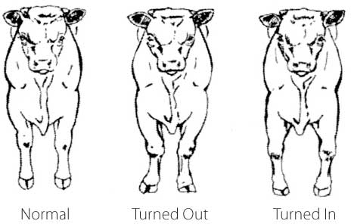
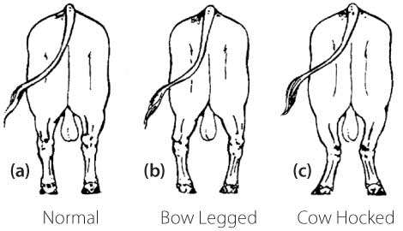
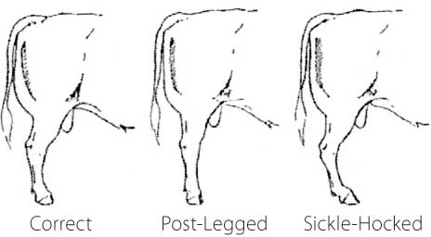
LIVESTOCK JUDGING
Structure
Structural correctness in all market animals is very important. Market animals have to be functional, not only for production, but for their health and well-being as well. Animals being fed in a feedlot or on pasture have to be able to move and walk to get feed resources. This makes structural correctness crucial. Functional market steers should be square on all four corners of their skeleton, all hooves should be of equal size and facing forward rather than turning in or out, their neck should come out at the top side of their shoulder at a forty-five degree angle, and they should
be long and level from hooks to pins. When evaluating structural correctness, look for the animal to cover its tracks (back feet should plant in the tracks where the front feet lift off), as well as maintaining levelness of their topline, and offer flexibility to their hock. Sickle-hocked and post-legged market steers are not desirable. From behind, legs should hit the ground straight and forward rather than bowlegged or cow-hocked. Market steers should also be heavy boned, stout constructed, and be strong-pasterned with a forty-five degree angle set. An accurate depiction of these traits is shown below:
http://www.brahman.com.au/technical_information/selection/structureAndLameness.html
http://www.brahman.com.au/technical_information/selection/structureAndLameness.html

Slide 11
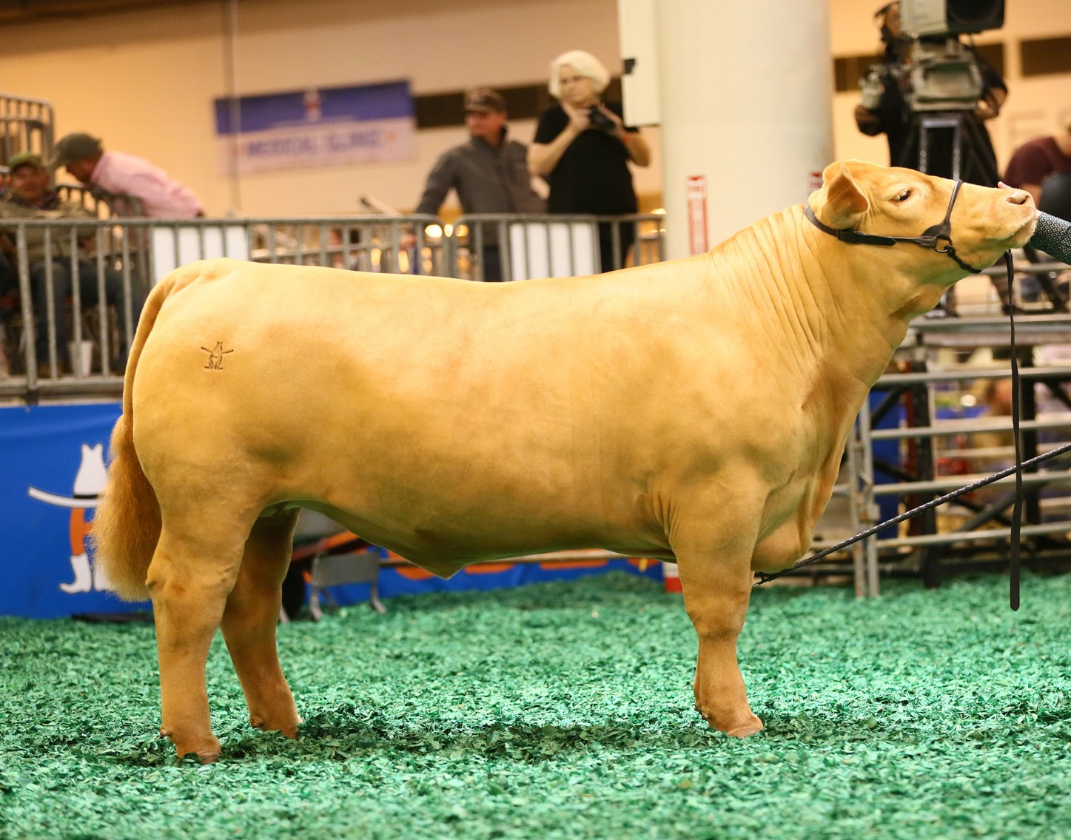
LIVESTOCK JUDGING
Balance
Balance is the combination of muscle, finish, and structural correctness. All market livestock need to be proportional in terms of their frame work, body mass, and muscularity, while maintaining structural correctness. Evaluating their angles and making sure that everything looks like it fits on the animal correctly is very important. Depth of flank in relationship to chest depth is also a key visual indicator that livestock are balanced. Adequate bone mass in relation to shape and muscling is critical. There is a difference between eye appeal and balance. Eye appeal describes livestock that are aesthetically appealing to an evaluator. The sharpness or cleanliness of a steer’s neck and the way it lays onto their shoulder may be an advantage or a disadvantage to the way the steer balances from the side. Hip and hind leg
construction, as well as tail head placement, also contributes to the overall balance of a market steer.
Balance and Eye Appeal: Ideal Steer
Levelness of Lines
Hip and Hind Leg Con- struction Tail
Head Placement
Cleanliness of Neck
Depth of Flank
Depth of Chest
2
3
1
4
1
5
6
Market Lambs and Goats:
Muscle Evaluation
When judging market wethers, muscle shape and expression is of upmost importance. Specifically in market lambs and goats, the forearm, rack, loin and leg are the four major areas indicating muscularity. It is imperative to analyze a lamb or goat from all angles, including from above, from behind, and from the front, to get a good idea of the true amount of muscle the animal possesses. After visually analyzing the wethers, it is a good idea to move in for closer inspection and handling if the specific judging contest allows evaluators to do so. When handling a lamb or goat, start by placing a gentle yet firm hand on the rack of the animal, which is located right behind the shoulder blade.
From there, move your hand down the wether’s back from the rack all the way to end of the loin, feeling for width, expression and firmness as you go. Handling the leg muscle is also recommended, primarily to get a feel for mass and firmness throughout the lower third.

Slide 12
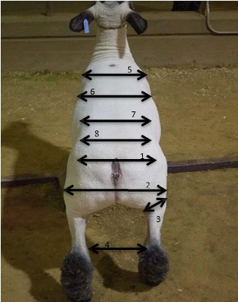
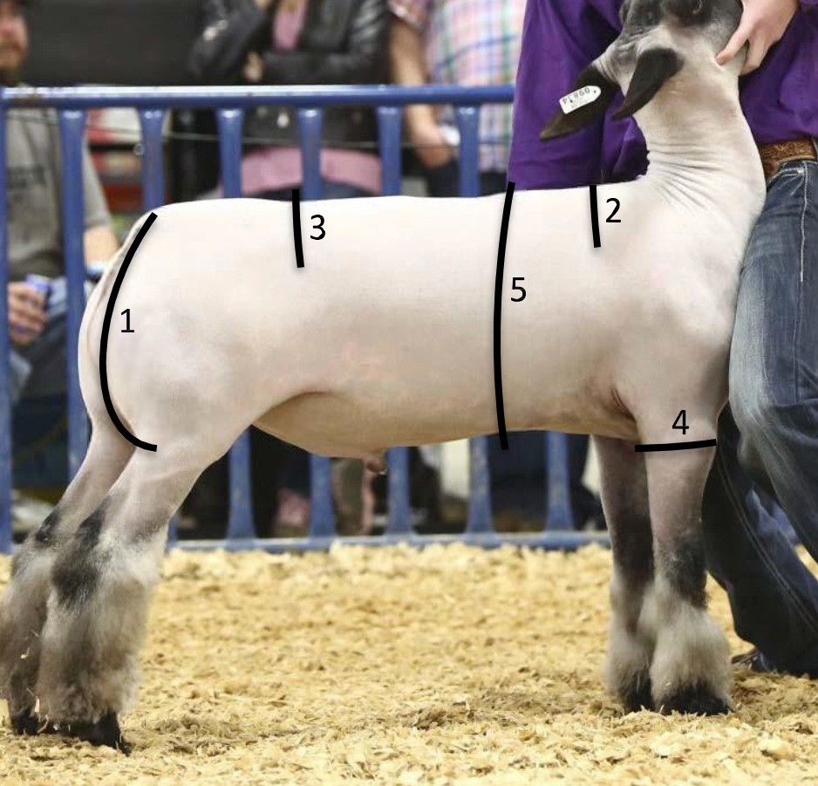
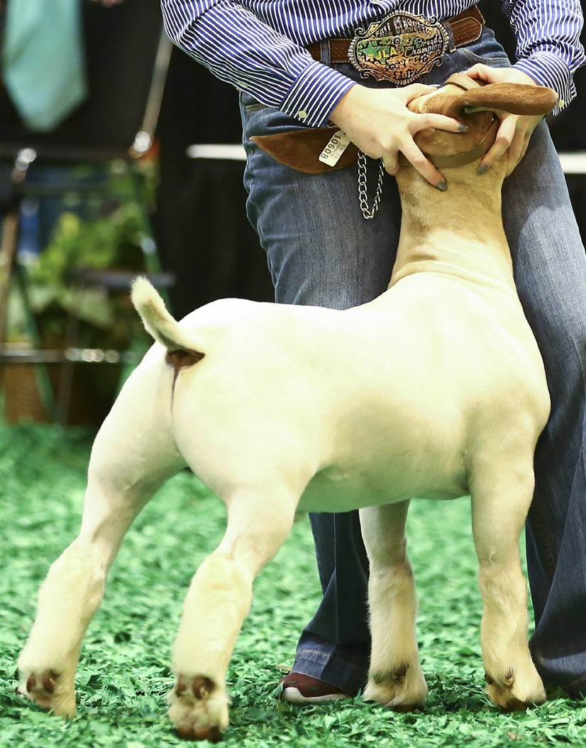
LIVESTOCK JUDGING
In addition to judging the sheer product and power that you see in a wether, it is also essential to look at muscle indi- cators such as base width and squareness of hip. A naturally big-hipped, wide-made lamb or goat will have the ability to lay more muscle and mass onto their skeleton, where as a narrow-based animal doesn’t have the frame to carry as much muscle.
These characteristics are illustrated in the diagrams below:
Muscle Indicators: Rear View (Left)
Pin Width
Width from Stifle to Stifle
Shape and Boldness of Lower Quarter
Base Width
Muscle Indicators: Top View (Left)
Width and Shape of Rack
Boldness of Rib
Width and Fullness of Loin Edge
Width and Squareness of Hip
Muscle Indicators: Side View (Right)
Turn to Leg
Expressiveness of Rack
Fullness of Loin
Width of Forearm
Depth and Spring of Rib
3
2
Muscle Indicators: 3/4 View (Left)
Turn to Leg
Expressiveness of Rack
Fullness of Loin
Width of Forearm
Depth and Spring of Rib
Base Width
1
1
5
4
6
6

Slide 13
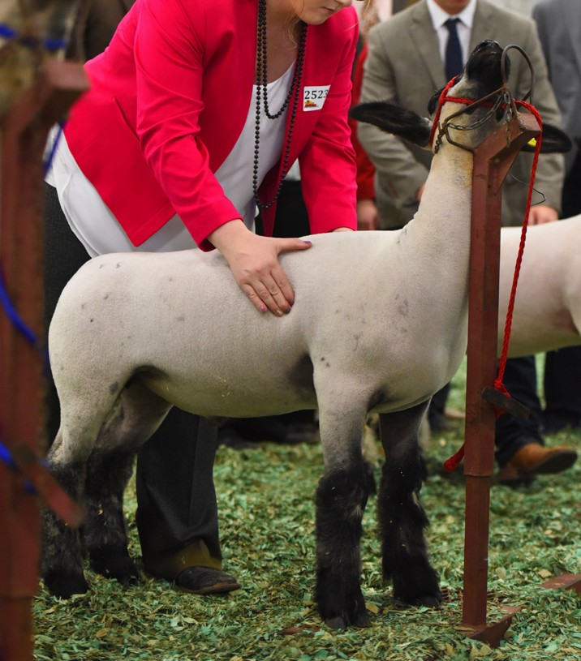
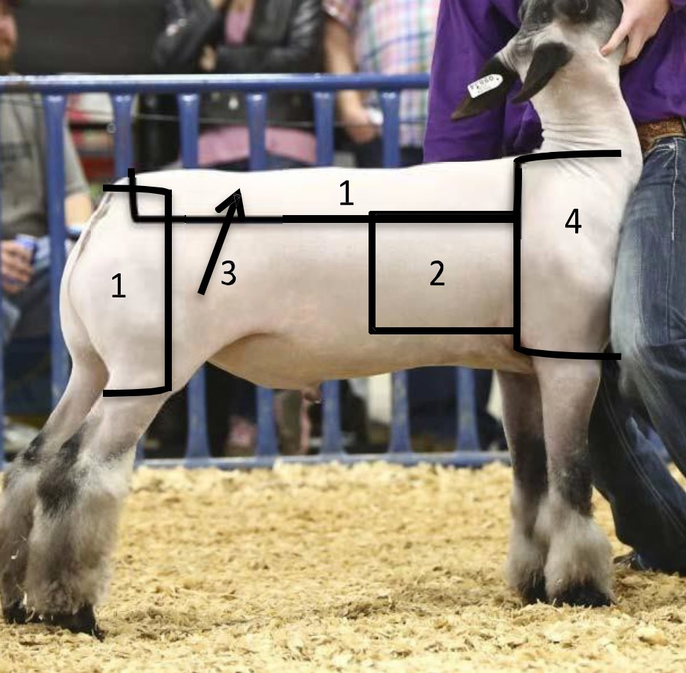
LIVESTOCK JUDGING
Evaluation of Finish
While mass is extremely important in a market lamb or goat, it is crucial to know the difference between mass resulting from muscle and mass resulting from fat or finish. To the untrained eye, muscle mass and fat can look very similar. When evaluating finish, first look at the “big picture” of the animal. Determine whether he is expressive and descript in his muscle pattern, or if he is softer and plainer about his shape. Too much of either attribute is not ideal, but you can use our evaluation criteria to weigh all of the variables and ultimately decide which animal has the most product in terms of quality.
Fat cover is absolutely necessary in market wethers. Market lambs and market goats have an ideal fat thickness range of about .15”-.30” with some variation to be expected. Finish can be evaluated by handling the animal, as well as visually analyzing areas where fat is typically deposited. As a rule, an animal matures from front to back, top to bottom. This means that the lamb or goat will first begin to deposit fat in areas such as the chest floor, shoulder pocket, and over the rib. Then, as the animal matures and fattens, he will start to lay fat in over
his loin edge, in his flank, and over his hip and dock. The last place a sheep will deposit fat is in between his back legs, also known as the cod. Market ready lambs and goats need to be smooth yet firm in their muscle pattern and finish. A sheep that does not have enough finish will look flat ribbed, handle very firm, and lack overall smoothness.
Alternately, an over-finished animal will look ultra-smooth, but will handle very soft and will likely start to look older and more mature through his front end. A lamb or goat with the ideal degree of finish will be smooth about his rib and body, yet expressive and firm over his rack and loin and down through his lower leg. Handle the wether over his top and over his rib. If he handles soft or is non-descript in his muscle pattern, or if you cannot feel ribs by lightly rolling your fingers over his rib cage, he is over-conditioned. Consider finish heavily when placing your class, as it is very important in both the look and, most importantly, the carcass quality of the animal. These traits are illustrated
below:
Finish Indicators: Handling Over Rib (Left)
Finish Indicators: Side Profile (Right)
Expressiveness Muscle Pattern
Smooth Over Rib
Full Loin Edge
Clean Fronted

Slide 14
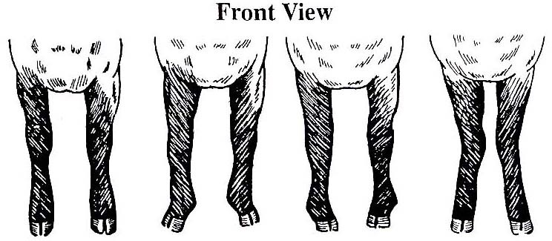
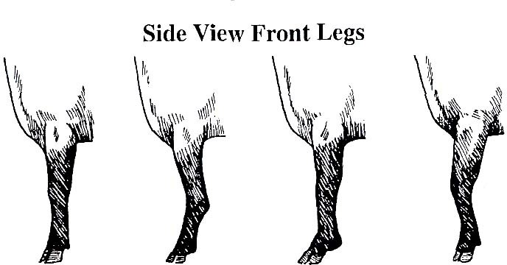
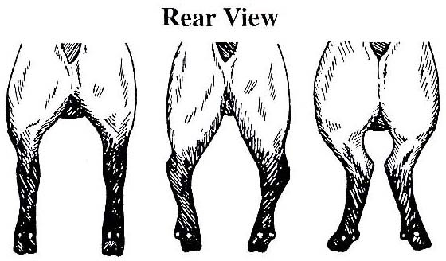
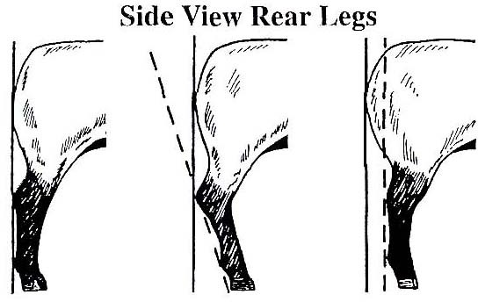
LIVESTOCK JUDGING
Structure
Evaluating structural correctness is of top priority when it comes to placing a class of market animals. Skeletal quality can be evaluated by studying the topline, hip shape, hoof and leg placement, and head and neck placement. The ideal market lamb or goat will have a forty-five degree angle set to his pastern on all fours, with his hooves straight and forward facing. When evaluating from the side, look for a slight set to the knee. Too much set to the knee, also referred to as calf knee, is undesirable. Likewise, the animal should not be too straight or over at the knee either, as these traits can cause some soundness issues as well. In the hind leg, the lamb or goat should be neither sickle-hocked nor post-legged, but instead hit the ground square on his corners and maintain a slight set to the hock. Once feet and leg soundness has been evaluated, the evaluator may move up to the topline and neck placement. The wether should be smooth and level across his top, and his neck should come straight up out of the
top of his shoulder at a ninety degree angle. In addition to being skeletally correct, the ideal market lamb or goat will be big boned, stout featured, and flexible when in motion. These traits are shown below:
http://www.danekeclublambs.com/SheepFeetandLegStructureTest.html

Slide 15
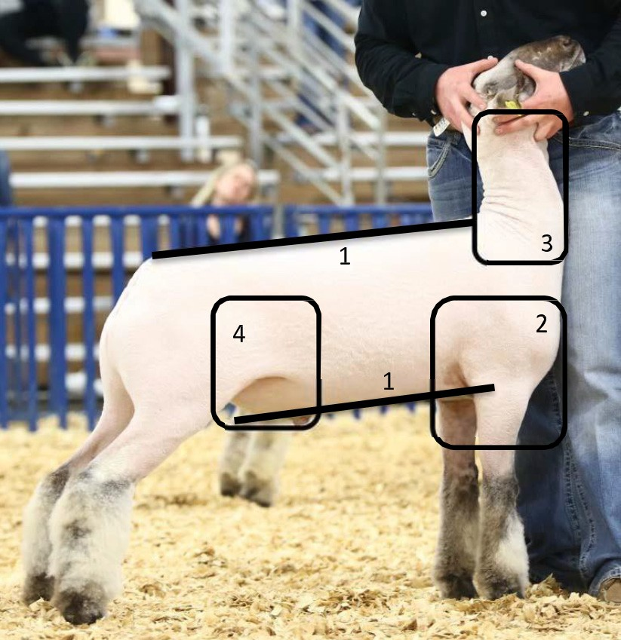
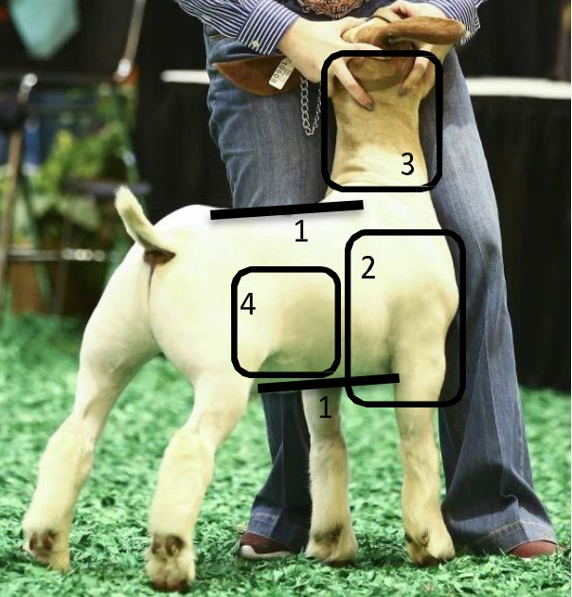
LIVESTOCK JUDGING
Balance
As with all of the characteristics discussed so far, balance and eye appeal is essential in today’s market show industry.
For a wether to balance up well, he must combine muscle, structural correctness and finish, all while maintaining an eye appealing package. A balanced sheep will have plenty of muscle while maintaining the appropriate degree of
finish, allowing for an overall smooth and attractive looking show wether. Cleanliness and levelness of lines in sheep shows as shallow chested and gets progressively deeper as you move back into a deep, full flank, and is necessary to complete a balanced appearance. The lamb or goat should be long and clean about his neck, which should connect smoothly to the top of the shoulder. A smooth, level top line and hip design will add to the balance of the wether as well. Balance is proportionate from front to back and top to bottom, and is a characteristic that certainly shouldn’t be taken lightly when evaluating livestock at a judging contest. You can view these traits below:
Balance and Eye Appeal: Ideal Market Lamb
Cleanliness and Levelness of Lines
Tall Fronted
Long, Extended Neck
Deep, Full Flank
Balance and Eye Appeal: Ideal Market Goat
Cleanliness and Levelness of Lines
Tall Fronted
Long, Extended Neck
Deep, Full Flank

Slide 16
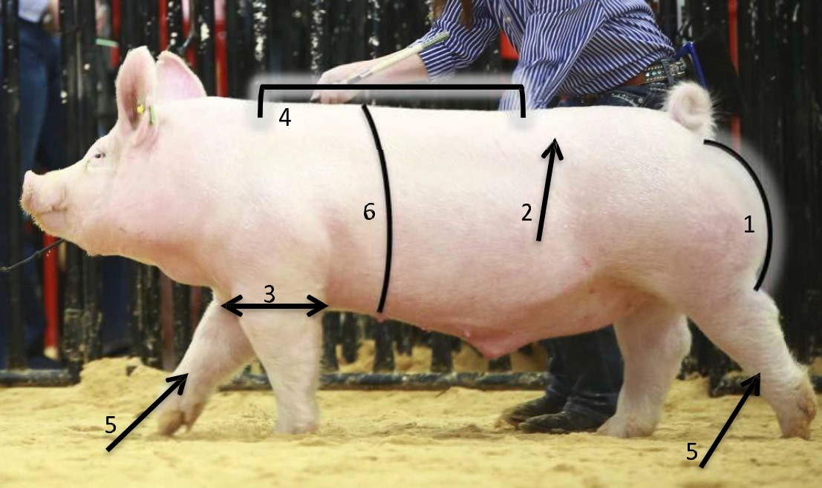
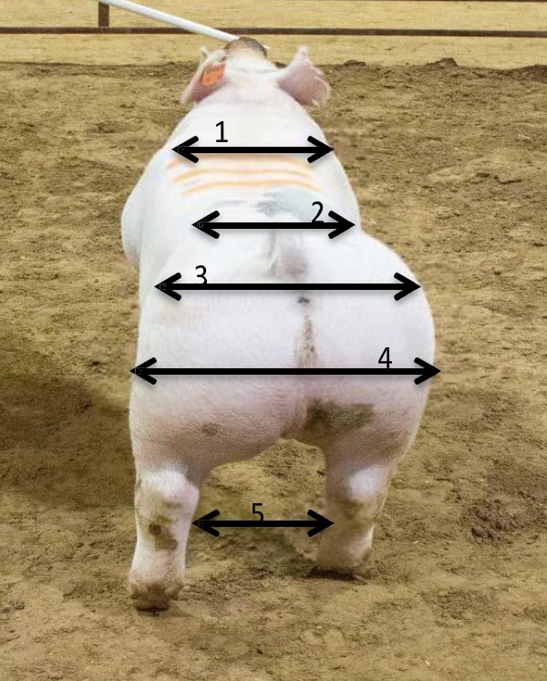
LIVESTOCK JUDGING
Market Hogs:
Muscle Evaluation
Evaluating swine is usually a little different than other species as the four barrows or gilts are loose in a pen, identifiable by the number on each hog’s back. Muscling in a hog can be assessed in five particular places: the forearm, blade, top, loin, and ham. When looking at the blade and loin from behind, a heavy muscled hog will be shapely and expressive in his muscle pattern. Other great indicators of muscle are base width and bone size. Swine that are wide based and big boned will carry more product than those that are narrow based and frail in their bone
work. Hogs should be heavy muscled from all viewpoints, but especially when viewing from behind and over the top side. From the side, the boldness of rib in a hog is a good indicator of natural width and volume of muscle. In general, a heavy muscled hog will maintain his width and expression as you work from front to back.
Muscle Indicators: Side View
Turn to Ham
Fullness of Loin
Width of Forearm
Muscle Expression Through Blade and Top
Bone Size
Depth and Spring of Rib
Muscle Indicators: Rear/Top View
Width Behind Shoulder
Width and Fullness of Loin
Width of Hip
Width from Stifle to Stifle
Base Width

Slide 17
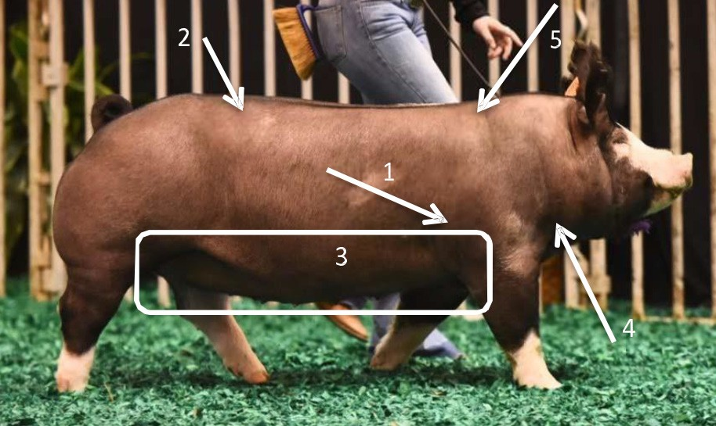
LIVESTOCK JUDGING
Evaluation of Finish
Pigs, like any other species of livestock, fatten from front to back and top to bottom. There are numerous places to use to observe fat deposition on a hog, including the jowl, elbow pocket, loin edge, and seam of the ham. The ideal market hog will be relatively lean while still maintaining muscle and expression. Specifically, the acceptable range of fat is .55” to .90”. It is important to have a leaner, trimmer design with little to no excess fat in the jowl, underline, or over the shoulder blades, or in the seam of the ham. A groove down the top and a dimple right in front of the tail are also good features indicating leanness. In production agriculture, once a market hog reaches their final destination to be harvested, they are analyzed and sold using a grid. This grid emphasizes carcass weight and percent lean or percent muscle. A carcass can either receive a premium, discount, or regular market price depending on their percent lean in relation to their hot carcass weight. Therefore, heavy muscled, leaner designed barrows that are higher cutability is ideal for market hogs. The least desirable combination is having a light muscled, low cutability hog that is very over-
conditioned.
Finish Indicators:
Elbow Pocket
Loin Edge
Underline and Lower Third
Jowl
Top of Blade
Structure
Structural correctness is essential to achieve the highest quality carcass. If a hog cannot hold its own weight or move freely, it will be difficult to acquire the appropriate nutrients needed to grow and mature to maximum potential.
Ideally, market swine will be big-boned, strong-topped and correct in their angles. A structurally sound barrow or gilt will travel around the pen with ease, exemplifying flexibility and comfort through the shoulder, knee, spine, hip and rear leg structure. Both the front and rear pasterns should be set at about a forty-five degree angle and the hocks should be set to approximately twenty degrees to eliminate unnecessary pressure or strain on the joints. A slight an- gle to the scapula and hip should also be recognized, as hogs that are too straight in either of these areas will have a difficult time traveling comfortably. Other structural issues could include placement of front and rear legs and swell- ing of joints, both of which will affect the functionality of the pig. When evaluating structure in market swine, take note of any leg placement issues such as sickled-hocked or post-legged rear legs or buck-kneed front legs, as each of these structural flaws is likely to significantly affect the hog’s soundness. Lastly, market swine should be big-footed and exhibit adequate bone substance. Soundness and structure is critical in market swine, therefore heavy emphasis should be placed on this category when evaluating a class of barrows or gilts.

Slide 18
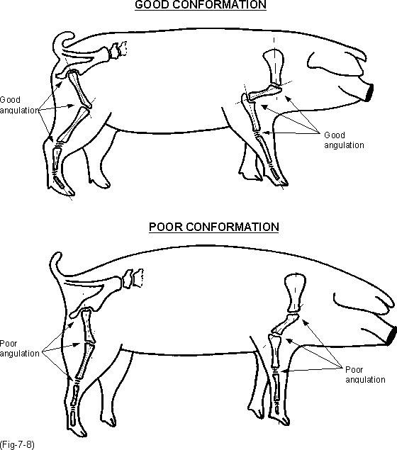
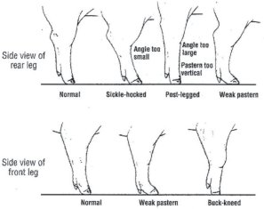
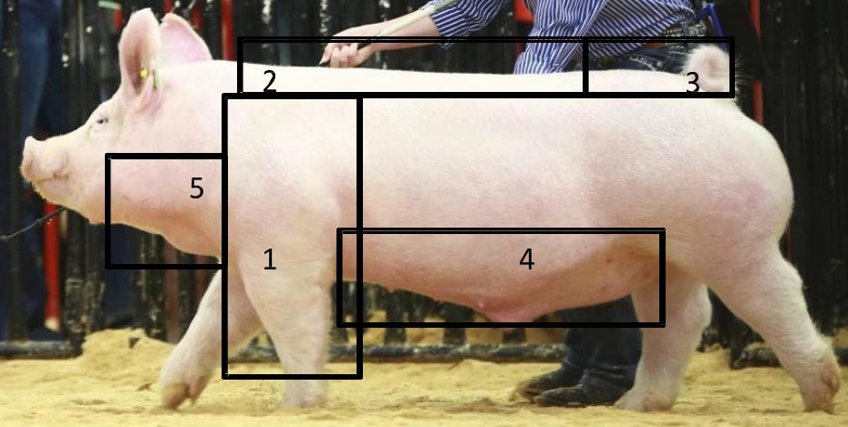
LIVESTOCK JUDGING
http://porkgateway.org/resource/genetic-aspects-of-fe- male-longevity/
http://porkgateway.org/resource/genetic-approaches-to-im- proving-health-and-reproduction-in-cattle/
Balance and Eye Appeal
Balance and eye appeal refers to the combination of structural correctness, muscle, and finish.
Pigs that combine these traits very well are sometimes said to be extra “complete.” A hog that is correctly balanced is proportional and pleasing to look at on the profile. Correctly balanced hogs will be tall fronted with their neck
attaching high onto the top of their blade, level topped, and will set high in their tail setting. Structure can either help or hinder a hog’s eye appeal as well. Criticisms from a balance standpoint include swine that are steep hipped, have a weak topline, or are low fronted, among other similar traits.
Ideal Market Swine: Balance and Eye Appeal
Tall fronted
Level Topped
Level Hipped
Clean Underline
Clean Jowl

Slide 19
LIVESTOCK JUDGING
ACTIVITY: SPEED JUDGING
Speed judging is a fun and interactive spin on livestock judging. The contest provides embedded education and immediate results.
Objectives:
Teach Livestock Evaluation
Promote Quick Decision Making
Increase Livestock Production Knowledge
Create a Fun and Competitive Environment
Competition with Instant Results
Rules:
Two livestock animals (or pictures of two livestock animals) are presented to be evaluated at a time
Moderator asks question related to two animals
Animal #1 is positioned to contestants left and animal #2 on the right respectively
Participants have two numbered or colored chips (blue representing #1; red representing #2)
Participants have 20 seconds to answer after the question is presented
Moderator describes to audience how the question relates to livestock production
Encourage parents/adults and eliminated contestants to watch other contestants from the stands
Participants place the chip or number that corresponds to the wrong answer in the bucket and hang on to the chip they believe answers the question correctly
Moderator will report the correct answer. Participants holding the correct chip are still in the game. Participants holding the wrong chip are eliminated from the game.
Equipment Required:
Poker Chips
Two Buckets
Microphone and Sound System (Depending on Audience Size)
Rope or Chalk to Create Barriers for Contestants – to keep from getting too close to livestock
Livestock or photos showing different traits

Slide 20
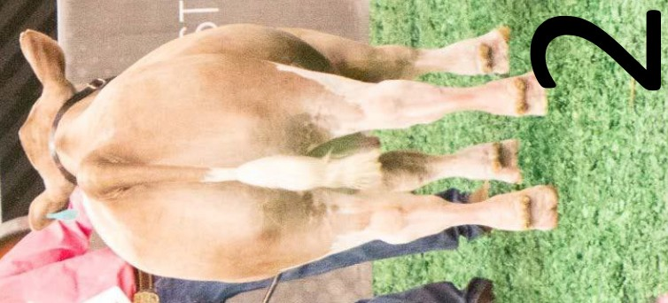
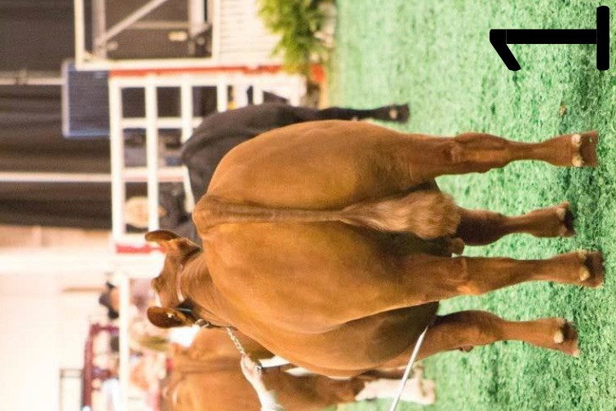
Steers: Between 1 and 2, which steer is wider constructed and heavier muscled from behind?

Slide 21
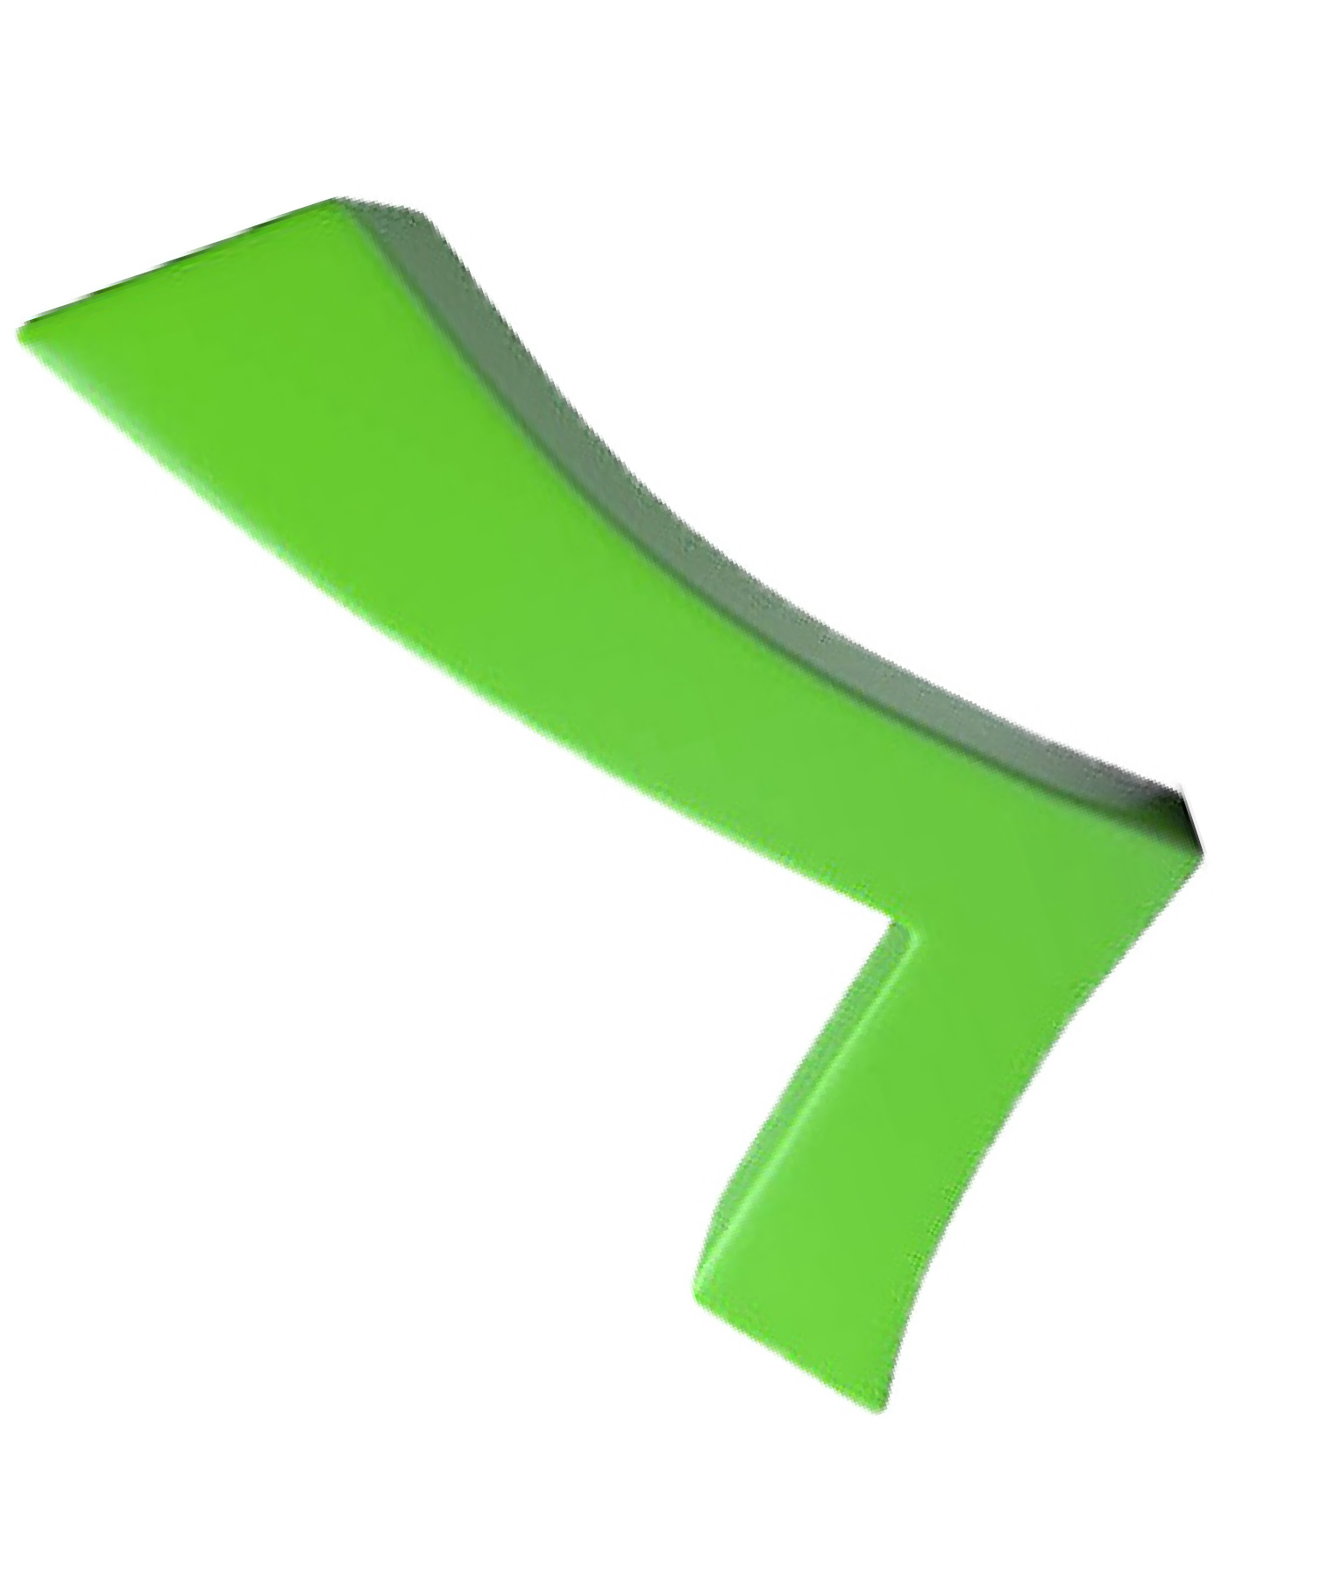
ANSWER
Steers: Between 1 and 2, which steer is wider constructed and heavier muscled from behind?

Slide 22
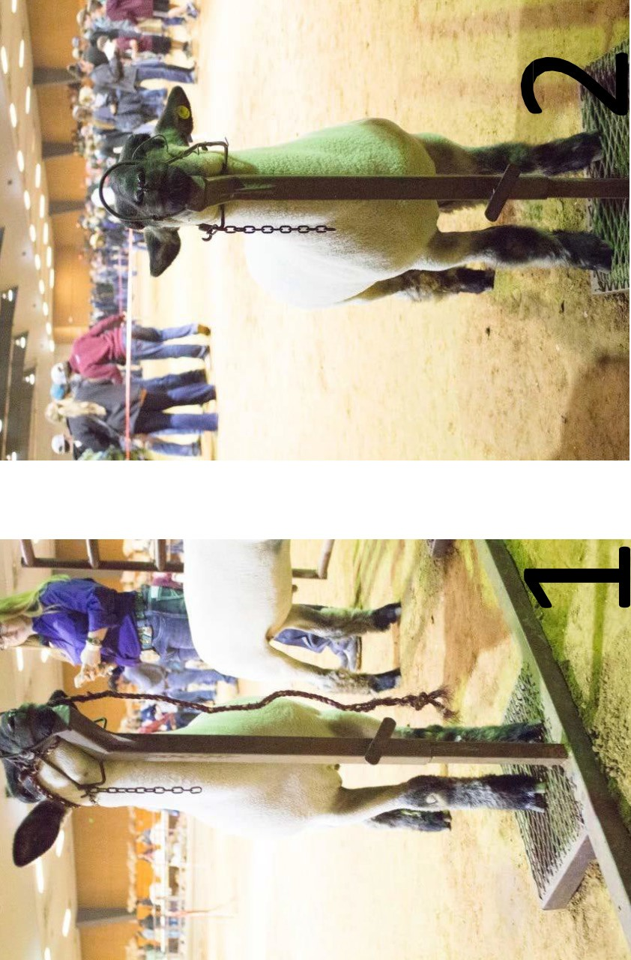
Sheep: Between 1 and 2, which lamb is wider based and bigger through his forearm?

Slide 23
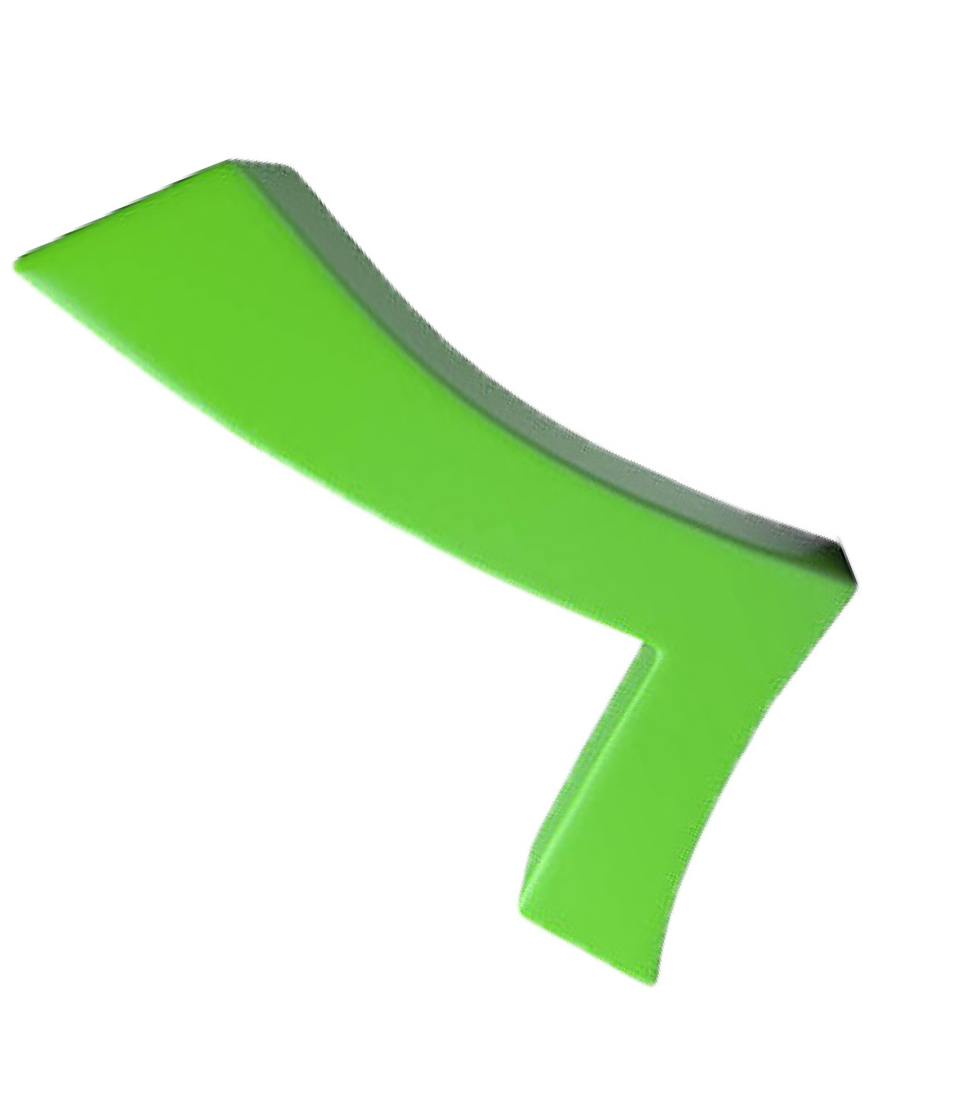
ANSWER
Sheep: Between 1 and 2, which lamb is wider based and bigger through his forearm?

Slide 24
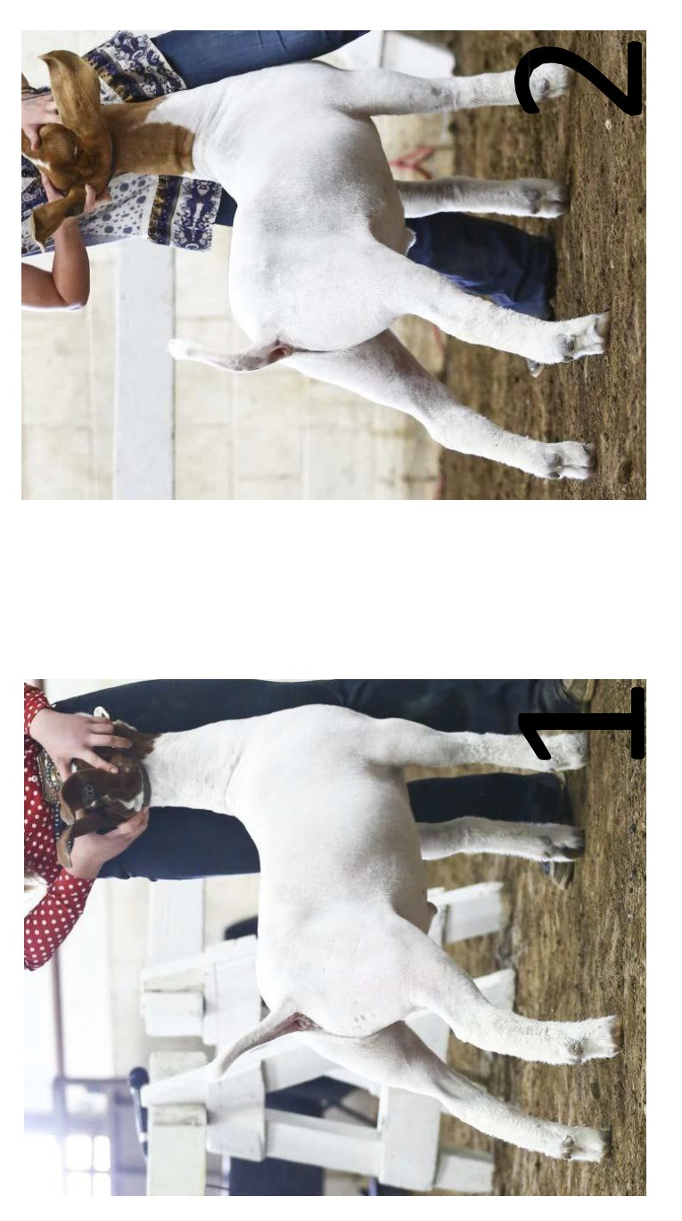
Goats: Which goat is stronger behind his shoulder and bigger hipped?

Slide 25
ANSWER
Goats: Which goat is stronger behind his shoulder and bigger hipped?

Slide 26
Swine: Which hog is softer middled and carries more finish?

Slide 27
ANSWER
Swine: Which hog is softer middled and carries more finish?

Slide 28
LIVESTOCK JUDGING
REFLECT:
While these guidelines are relatively straight forward and all-inclusive, remember that livestock judging is an opinion based activity. Keep this in mind when participating in contests, and understand that you may see the animal differently from the officials that day.
How important is it to evaluate as many different sets of livestock of varying breeds, ages, and quality as possible?
Who can help you to fine tune your judging skills?
APPLY:
Travel to as many livestock producers, friend’s facilities, and judging contests as you can to perfect your evaluation skills. Partake in simple activities such as speed judging to exercise and train your brain to pay attention to detail. Ask for help from your County Extension Agents and Agricultural Science Teachers on tips and tricks they have when it comes to accurately evaluating livestock.
How might you use the information you learned and skills you practiced in a career or purchasing decision?

Slide 29
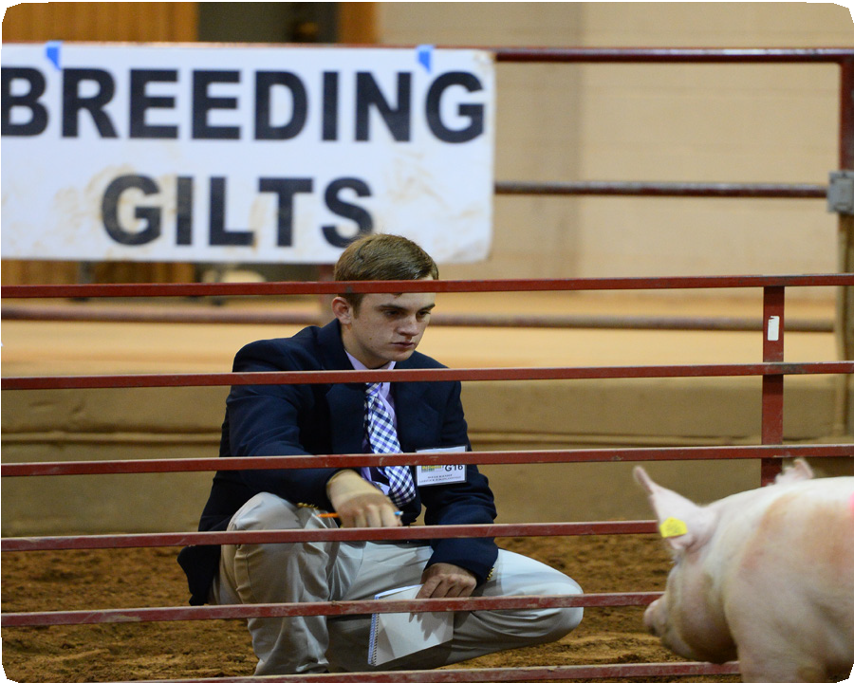
4-H LIVESTOCK JUDGINGLessons
BREEDING ANIMAL EVALUATION
EXPLORE THE CONTENT:
The evaluation of breeding stock is instrumental in the successful production of all livestock, regardless of species or targeted endpoint. Whether your goal is to raise a competitive animal
for the show ring, produce a high quality carcass for human consumption, or create a top notch sire for your herd, evaluation and selection of your breeding stock is of utmost importance to ensure a fruitful outcome. Livestock judging contests enable you to focus your attention on several key characteristics of a good breeding animal and recognize the undesirable traits that may be associated with a breeding animal. With that, you are given the opportunity to place a class of individuals based on your educated assessment of each animal and the class as a whole.
Breeding animals need to be functional, have adequate skeletal width and muscling, maintain balance and eye appeal, and exhibit characteristics that promote growth and performance. Livestock judging is somewhat based on personal opinion, therefore it is important to remember that officials could vary slightly from contest to contest. However, understanding the basics of a quality breeding animal will help you immensely when evaluating and placing a class.
TIME:
60-90 minutes
MATERIALS NEEDED:
One powerpoint or live animal class of each species (ewes, does, gilts and breeding heifers).
OBJECTIVES:
The 4-H member will:
Learn the criteria used when evaluating a class of breeding animals in a 4-H/FFA livestock judging contest
Understand common anatomy and data associated with breeding livestock
Appreciate the importance of breeding animal evaluation
Breeding Heifers:
Functionality
Structure, body capacity and overall volume are critical when evaluating a breeding heifer. First and foremost, the heifer must be structurally sound. This means that the heifer should be able to move around the pen with ease. She should cover her tracks, meaning that her back feet should plant in the tracks where her front feet lift off. Any signs of pain, such as a limp or a short step, should be noted and considered heavily when placing the animal.
One should also take note of the hock and hoof placement when the heifer is both in motion and at rest. When stationary, the heifer should plant all four feet square on the corners of her skeleton. Pay close attention to her knees and hooves, as they should be straight up and down, showing no signs of turning in, turning out, having too much angle, or buckling over at the knee.
The same should be considered when evaluating the hocks and hind feet, ensuring that the heifer is neither cow-hocked nor bow- legged. The heifer should show flexibility in her knee and hock joints, and possess a forty-five degree angle set to the front and rear pasterns. In motion, the heifer should be strong when her foot hits the ground and refrain from rolling her hocks inward or outward as she shifts her weight from leg to leg. Body capacity is

Slide 30
LIVESTOCK JUDGING
extremely important in a production female as well. In order for the heifer to carry a good size calf to full term, she must be broody and productive through her center body. Depth of body and depth of flank are two good indicators of a productive heifer or cow. With that, the heifer should be long-bodied and bold-ribbed, expressing adequate body capacity and overall volume that can eventually carry a calf without difficulty.
http://www.aberdeen-angus.co.uk/the-society/breed-assessment-booklet/
Functionality:
Length of Body
Depth of Boldness of Rib
Depth of Center Body
Depth of Flank

Slide 31
LIVESTOCK JUDGING
Growth and Performance
Because cattle are typically sold by the pound, growth and performance in breeding heifers is extremely important. An optimal female should possess an adequate frame size to support her mature weight. An easy-keeping, easy- feeding heifer is imperative to a producer, as the main goal remains to get the most output from a heifer for the least amount of input possible. When judging breeding heifers, focus attention on evaluating a few areas that will indicate the potential growth and performance of a young heifer. First, look at the length of the cannon bone. The cannon bone is the major bone between the knee and the pastern in the front leg and between the hock and the pastern in the hind leg. The length of the cannon bone is a good indicator of how tall that heifer will be at maturity. Evaluating the length of face and length of body can also give you some insight on the potential frame size of the heifer. Once you have evaluated the heifer on the structural level, take into account the current weight of the heifer and compare that to your growth indicators. If a heifer has a short cannon bone, face and body and already weighs 1000+ pounds, you can expect that the heifer will likely stay close to that height and size for the rest of her life. Likewise, if you have a heifer that has long features and is large framed, take note of her body condition to help you determine whether she can remain healthy and productive at her mature weight. The most important goal in assessing growth and performance is to decide if the heifer will be able to maintain her structural integrity at her mature weight and still be able to efficiently convert nutrients well enough to keep the enough flesh on her frame size. These factors will
significantly affect her ability to become pregnant, carry a pregnancy to term, raise a healthy calf and breed back.
https://msu.edu/~ritchieh/historical/cattletype.html
Growth and Performance Indicators:
Length of Cannon Bone
Length of Body
Length of Face
Frame Size

Slide 32
LIVESTOCK JUDGING
Skeletal Width and Muscling
While the primary job of the heifer is to produce calves, she still needs to possess some market animal qualities to pass on to her offspring. The ideal heifer will have some base width, which can be evaluated by studying the heifer from the top of her shoulder to the ground from the front, and from the top of her hip to the ground from behind. Watch the heifers in motion and at rest, focusing specifically on where their hooves hit the ground. If they track wide, meaning they have a good amount of space between their knees, legs and hooves when they walk, they will likely stand wide when they stop. In an ideal situation, we could draw a straight line from the point of the shoulder to the hoof and from the pin bones of the hip to the hoof, as the goal is to have heifers that stand as square as possible on all four feet. After studying base width, change your focus to muscling. Much like a steer, muscle is a valued attribute of a quality heifer. However, heifers generally have a flatter, more proportionate muscle pattern versus a round quartered, heavy muscled calf you might find in the market steer class. Muscle indicators in heifers include a big top, big hip, base width, and thickness in the forearm and stifle. A wide-based heifer will generally have more muscle shape and expression than a narrow-based calf, so pay close attention to this attribute as you go through the class.
The wide-based, big-ended, smooth-muscled heifer should work its way towards the top of the class.
Muscle Indicators
Thickness in Stifle
Width of Forearm
Strength of Top
Hip Shape

Slide 33
LIVESTOCK JUDGING
Balance and Eye Appeal
When evaluating breeding heifers, it is imperative to consider balance and eye appeal. Balance is characterized by clean lines, smooth muscle pattern, refined features, and profile, and should be strongly considered when judging a class of breeding heifers. While adequate bone size is essential, the heifer should be feminine and functional about her bonework. When looking at heifers from the side, first take note of the smoothness up through their front ends. A high quality heifer will demonstrate a refined neck, head and shoulder. This means that the female should be smooth fronted with feminine face and a long, clean neck. Bold shouldered, thick necked heifers do not exhibit the attractiveness that a breeding female needs to possess. From the neck work back into a smooth, level topline and clean underline. The heifer should not cut up in her flank, meaning that she should maintain her depth of body from her chest floor to her rear flank.
Balance and Eye Appeal
Feminine Head and Neck
Feminine, Functional Bonework
Refined, Smooth Shoulder
Level Topline
Clean Underline
Breeding Ewes and Does: Functionality
When it comes to evaluating breeding sheep and breeding goats, the traits to look for in the two species are nearly identical. Similar to heifers, functionality is extremely important in ewes and does. Ideally these females are sound on their feet and legs and structurally correct from the ground up. Evaluation of breeding sheep and goats in a judging contest is generally done from a distance with the livestock free to move about the pen. This gives the evaluator ample opportunity to evaluate them as they move. As they walk around the pen, take note of where their foot hits the ground. The rear feet need to land in the tracks of the front feet and the ewes or does should show no signs of soreness in their muscles or joints. Hock and knee placement is crucial in ewes and does as well. The hock should
set at approximately twenty degrees when viewing the animal from the side and the leg should be straight up and down with the animal’s hip when viewing from behind. The knee should be straight and square with the point of the shoulder when looking at the ewe or doe from the front, and it should be set back just slightly when studied from the side. Some common leg structure flaws in ewes and does include sickle-hocked, cow-hocked, buck kneed and weak pasterns. Like heifers, a breeding ewe or doe needs to be big-bodied with some spring and turn to her rib.
A long bodied, big middled female is likely to have a much easier time carrying multiple lambs or kids than a shallow, thin made animal would. When judging breeding sheep and goats, it is important to place emphasis on depth of body
and depth of flank, along with roundness of rib, as all of these traits characterize a productive, broody female.

Slide 34
4-H LIVESTOCK JUDGINGLessons
Effective Note Taking
EXPLORE THE CONTENT:
Effective note taking is crucial when it comes to evaluating, comparing, and placing a class in a livestock judging contest. Furthermore, when it comes to giving reasons, it is important to have sufficient, detailed notes to later visualize the particular
animals in that class. The outline and organization of the student’s notepad, as well as the identification factors and descriptions used can greatly benefit or hinder the ability to recall the class.
Basic Outline:
The note-taking style you implement is primarily up to your judging coach, but a popular style is explained here and demonstrated below. A small notebook, such as a stenographer spiral, is desirable. You will hear many livestock judging veterans simply refer to it as a “steno.” Begin with a clean notebook page for each class. At the top of each page, contestants should write the name and class number of the class they are judging, as well as a spot for the final placing. Just below this, a small section should be vertically numbered one to four for initial impressions and identifiers. The identifying characteristics to write down include the gender, color/breed, unique markings, and any initial impression of muscling, frame size, or attractiveness. Upon placing the class, six boxes of equal size should be drawn below the primary observations section. This is where comparisons between each pair in the class will be noted. The advantages of the higher placing animal in each pair will be included in the left boxes, respectively. The three boxes on the right side will be split into two sections. The grants of the lower placing animal should be placed in the top section, while the disadvantages, or criticisms, will be placed in the bottom half of each box.
TIME:
20 minutes
MATERIALS NEEDED:
Four different hat styles
Note taking steno pad
Pencil
Stopwatch or timer
OBJECTIVES:
The 4-H member will:
Understand the importance of taking clear and concise notes
Be prepared to take organized, useful notes
Know what details to include in the notes for each class
ACTIVITY GUIDELINES:
Line up four different hats
Have students set up a steno pad as described in the notetaking section below
Set timer for 8 minutes
Have students take notes over this “class” of hats

Slide 35
LIVESTOCK JUDGING
https://www.stockshowboutique.com/products/custom-stock-show-striped-judging-notepad-style-1
Tips for Note Taking
Upon approaching a class at a contest, maintain a bit of distance to ensure you get a full view of the class and begin jotting down the big first impressions. Do not focus on a single trait and forget to look at everything else about the animal. Be sure to move around and study all aspects of the class. For example, when judging a set of market sheep, analyze the animals from the rear view, side profile, and front view. If the contest allows handling of the animals, never pass up the opportunity to do so. Adopt a method of shorthand to speed up the note-taking time to ensure the entire allotted time is not spent writing. Notes should be brief, while the rest of the time is spent getting a good mental image of each animal. Avoid memorizing the notes and rely more heavily on the features, both good and bad, that can be recalled from memory as shown below:

Slide 36
Class 1: Market Hogs 1-2-3-4 Black-belted Gilt Lean, Heavy Muscled White Barrow, erect ears Large Framed, Big Boned Red Gilt, down ears Light Muscled, Fat White Barrow, down ears Small Framed, Fat, Sound
1/2 leaner, trimmer middled fuller ham wider based carcass with more % lean | 2/1 larger framed later maturing - more excess trim lacks the cutability
2/4 bigger outlined pounds heavier more production oriented heavier carcass | 4/2 soundest of 4 - early maturing 1 of 2 fattest pigs
4/3 heavier muscled structurally correct | 3/4 larger framed - lightest muscled 1 of 2 fattest poorest composition

Slide 37
LIVESTOCK JUDGING
DO:
Activity: HAT JUDGING
Objectives:
Teach Note Taking
Promote Detail Oriented Thinking
Increase Awareness of the Differences Among Four Similar Things
Create a Fun and Competitive Environment
Competition with Instant Results
Rules:
Four hats (or pictures of four hats) are presented at one time for evaluation
Contestant is given 8 minutes to take notes on the class of hats
The hats are positioned left to right, 1-4, respectively.
Participants have their own sheet of paper formatted for note taking
Participants are then turned with their backs towards the hats
Moderator asks specific, detailed questions about the hats
Students are allowed to use the notes they took only to answer the questions
Participants are chosen to answer various questions asked by moderator
Moderator will report the correct answer. Participants that have the correct answer written on their notes sheet advance to the next round of questions. Those with no notes on the question asked are eliminated.
Equipment Required:
Four hats (or pictures of four hats)
Table to set hats on
Microphone and Sound System (Depending on Audience Size)
3-4 volunteers to check notes sheets and eliminate players
Sample Questions:
Of the four hats, which one is NOT a ball cap? Between hats 1 and 4, which hat has a mesh back?
Between hats 3 and 4, which hat has a curve to the bill? Which of the four hats is green in color?

Slide 38
LIVESTOCK JUDGING
REFLECT:
While you may not be asked questions in great detail at every contest, it is important to train your brain to pay attention to every little detail when judging livestock. Even the simplest question can damage your contest score if you happen to miss the minor detail it is referring to.
How can you practice evaluating and taking notes over what you see?
How does taking detail-oriented notes help you to avoid accidentally missing an important attribute of the livestock you are evaluating?
APPLY:
Travel to as many livestock producers, friend’s facilities, and judging contests as you can to perfect your note taking skills. Partake in simple activities such as hat judging to exercise and train your brain to pay attention to detail. Ask for help from your County Extension Agents and Agricultural Science Teachers on tips and tricks they have when it comes to taking quality notes.
Where else could you use the critical thinking skills learned through livestock judging?

Slide 39
4-H LIVESTOCK JUDGINGLessons
REASONS AND QUESTIONS
EXPLORE THE CONTENT:
At most 4-H/FFA contests in Texas, contestants will either answer questions or give a set of oral reasons regarding a particular class. This portion of a livestock judging contest is extremely important, as it is the contestant’s opportunity to defend his/her placing of the class. Questions are designed to prepare younger youth to give oral reasons as they move into older age divisions. Giving reasons teaches numerous skills including public speaking, organization, and effective communication. The questions portion of a livestock judging contest is for younger 4-H members, typically junior and intermediate age level, prepares them to give a set of reasons upon reaching the senior age division. These questions will begin to instill the correct terminology, comparison techniques, and thought process for the youth to learn and build on. Questions may be related to structure, muscling, productivity, functionality, identifying characteristics, or any other aspect of the class. For example, a question regarding a market steer class could be: “Between steers 2 and 3, which steer is wider based and heavier muscled?” For a market hog class, the questions could be address anything from erect versus down ears to structure, condition and more.
TIME:
20 minutes
MATERIALS NEEDED:
Four different kinds of fruit
Steno and pencil for notetaking
Activity Guidelines
Give students 8 minutes to judge the class followed by 4 minutes to prepare a set of reasons
Ask five questions regarding different aspects of the fruit
Reasons:
Oral reasons are an excellent way for the competitors to experience describing a class to another person or a group of people. When taking notes, it is recommended that the class be broken down into three pairs: a top, middle, and bottom. The majority of the comparisons made in a set of reasons will be between these pairs. There is a basic outline to follow when talking about a class of animals.
OBJECTIVES:
The 4-H member will learn:
How to prepare for and present a set of reasons
The types of questions in a contest
It is important to lay out a clear, concise image of the class.
To begin, state the class name and class placing in a statement such as: “I placed the market lambs 2-1-4-3”.
Then, go on to briefly describe your class winner in comparison to all three other animals in the class. An example of a description for a class winner would be: “I started the class with 2 as he is the most complete, structurally correct, and market-ready wether in the class.”
From there, each pair should be a comparison of the two animals within that pair. Starting with the top pair, one should introduce the pair with “I placed 2 over 1 in the top pair because…” and finish off that pair by comparing and describing the animals as they stand in class.

Slide 40
LIVESTOCK JUDGING
In each class, there will be grants and criticisms for each pair. Grants are the aspects of one animal that are more desirable than the other in the pair, while criticisms are those aspects that you would like to change about an animal. For example, in the bottom pair, a grant could be “I grant that 3 is a heavy muscled steer, but I criticize him for being too straight from hock to ground and over-conditioned today, so he rounds out the class.”
Presentation:
For a contest requiring contestants to give reasons, proper attire includes khaki pants, a nice shirt, a blazer, and a clean pair of boots or shoes. Upon walking into a reasons room, it is appropriate to stand about seven to eight feet from the official. Contestants should stand with their feet about shoulder width apart and their hands down and together to avoid distraction for the person listening to the reasons. Speaking clearly and confidently, enunciating words, and using proper sentence structure are extremely important when giving reasons. Contestants memorizing their notes can lead to forgetting exactly what he/she wanted to say, which in turn causes one to freeze up. In this situation, the contestant should take a deep breath and visualize the class in his/her head, which should immediately trigger talking points for each pair. It is ideal to go into the reasons room without notes, using only memory to lay out a set of reasons in order to prevent long pauses and loss of words. The appropriate voice level depends on the size of the room. Maintaining good eye contact and speaking at a steady pace so that each word can be heard, is
very important. The same format should be kept for each set of reasons and good transition words between pairs will keep the set moving and building. Beneficial transition words include “I realize,” “I agree,” “moving to”, or “in closing.” The appropriate amount of time to spend on a set of reasons is approximately a minute and forty seconds for performance classes. A minute and a half is appropriate for regular market or breeding classes.
DO:
Activity: Fruit Judging
Fruit judging is a fun and educational way to practice talking sets of reasons as well as answer questions on a class of similar objects. The contest provides embedded education and immediate results.
Objectives:
Teach Talking Reasons Sets
Practice Defending Your Position
Practice Answering Questions
Promote Detail Oriented Thinking
Increase Awareness of the Differences Among Four Similar Things
Create a Fun and Competitive Environment
Competition with Instant Results

Slide 41
LIVESTOCK JUDGING
Rules:
Four types of fruit (or pictures of four types of fruit) are presented at one time for evaluation
Contestant is given 8 minutes to take notes on the class of fruits
The fruits are positioned left to right, 1-4, respectively.
Participants have their own sheet of paper formatted for reasons and questions classes
Participants are then turned with their backs towards the fruits
Moderator asks specific, detailed questions about the fruits to junior contestants
Senior contestants are given 4 minutes to prepare a set of reasons
Students are allowed to use the notes they took only to answer the questions and prepare sets of reasons
Participants give a short set of reasons over the class of fruits
Volunteers give feedback and advice on reasons sets
Moderator provides correct answer to questions
Group discusses class as a whole
Example note-taking page for reasons and questions classes:

Slide 42
LIVESTOCK JUDGING
Equipment Required:
Four types of fruit (or pictures of four types of fruit)
Table to set fruit on
Microphone and Sound System (Depending on Audience Size)
3-4 volunteers to moderate questions and listen to sets of reasons
http://mahnwachen-helfen.info/mmp/f/fruit-collage/
Sample Questions:
Of the four types of fruit, which one is yellow?
Between fruits 1 and 2, which one is made up of two colors?
REFLECT:
While you may not be asked questions in great detail at every contest, it is important to train your brain to pay attention to every little detail when judging livestock. Even the simplest question can damage your contest score if you happen to miss the minor detail it is referring to. When giving reasons, use identifying terminology and be completely confident in your placing. Remember, you are defending your position and your primary goal is for the reasons judges to understand why you placed the class the way you did.
How can you practice giving reasons?
Can thinking about possible questions they may ask help you to identify and differentiate certain attributes of each animal?
APPLY:
Practice giving reasons as often as possible so that you are comfortable with the idea. Challenge yourself to think of questions for every class you judge so that you begin to think about every component of the class in front
of you. Reach out to older students, your County Extension Agent, your Agricultural Science teacher, and your friends. Whether it be to listen to a set of reasons or to help you in your preparation, many individuals are happy to assist you.
Describe other situations where you might use a strategy such as “reasons” for evaluating a purchase or decision you need to make.

Slide 43
MARKING INSTRUCTIONS
4-H Explore Project Book Evaluation
- Livestock Judging
1. Please read the statement in the left column of the table below. For each item listed below, mark the number in the left column for your level of understandg BEFORE the program; then mark the number in the right column for your level of understanding AFTER the program.
LEVEL OF UNDERSTANDING: 1 = Poor, 2 = Average, 3 = Good, 4 = Excellent | BEFORE |  |  |  | AFTER
As a result of participating in the Livestock Judging lessons and activities… | 1 | 2 | 3 | 4 | 1 | 2 | 3 | 4
I understand the different parts of the Livestock Judging contest.
I understand the specific traits to look for in the various livestock species.
I understand how to take notes more effectively in the contest.
I understand how to prepare and present a set of oral reasons.
I understand how I should present myself at a Livestock Judging contest.
I understand resiliency and working toward a goal, even when it may be difficult.
2. For each statement below, fill in the bubble that best describes you.
INTENTIONS TO ADOPT: As a result of participating in the Livestock Judging lessons and activities… | Yes | No | Unsure
I can recognize and select the higher quality animal in a class of livestock.
I will practice Livestock Judging techniques with my team.
I will work toward becoming a better Livestock Judging competitor.
I plan to speak to my County Extension Agent about potential practice opportunities.
I can work cooperatively in a team to make a decision by using the appropriate decision making method.
I can recognize change in my life and identify strategies to manage the change.
3. For each statement below, fill in the bubble that best describes your level of agreement with the following statements.
BEHAVIOR CHANGES: As a result of participating in the Ag Product ID lessons and activities… | Strongly Disagree | Disagree | Agree | Strongly Agree
I am more comfortable working in a team.
I am more willing to listen to others.
I am more comfortable speaking with others.
I am more confident in my abilities as a leader.
41795
Please continue on the back.

Slide 44
MARKING INSTRUCTIONS
3. What is the most significant thing you learned in the Livestock Judging lessons?
Please tell us about yourself.
Gender:
Female
Male
I consider myself to be:
African American Asian American Native American
White Other
I consider myself to be:
Non-Hispanic
5th 7th 9th 11th 6th 8th 10th 12th
Hispanic
Grade:
3rd 4th
Most of the time, you live . . .
Farm or ranch
Town less than 10,000
City between 10,000 - 50,000
Suburb of city between 50,000
Central city/urban center with more than 50,000
Please provide any additional comments below.
41795
Thank you!

